Slide 1
Using Surface-Area Weighted Average Concentrations (SWACs) to Optimize Sediment and Soil Remedies
Patty White, PG Jacobs
Summer 2023

Slide 2
Disclaimer
This seminar is intended to be informational and does not indicate endorsement of a particular product(s) or technology by the Department of Defense or NAVFAC EXWC, nor should the presentation be construed as reflecting the official policy or position of any of those agencies. Mention of specific product names, vendors, or source or information, trademarks, or manufacturers is for informational purposes only and does not constitute an endorsement or recommendation by the Department of Defense or NAVFAC EXWC. Although every attempt is made to provide reliable and accurate information, there is no warranty or representation as to the accuracy, adequacy, efficiency, or applicability of any product or technology discussed or mentioned during the seminar, including the suitability of any product or technology for a particular purpose.

Slide 3
Patty White, PG Scientific Technologist
Speaker Introduction
Jacobs
MS Geology, University of Washington
PG, Virginia and Washington
Assessment and management of contaminated sediment sites since 1992
Technical support for Navy contaminated sediment sites since 1999 (Washington D.C., California, Washington, Virginia, Connecticut, Hawaii, Guam)
Navy: Department of the Navy
PG: Professional Geologist

Slide 4
Presentation Overview
Introduction
SWAC Methodology
Case Study #1 – MCB Quantico
Case Study #2 – Portland Harbor
Other Site Examples
Wrap-up
MCB: Marine Corps Base

Slide 5
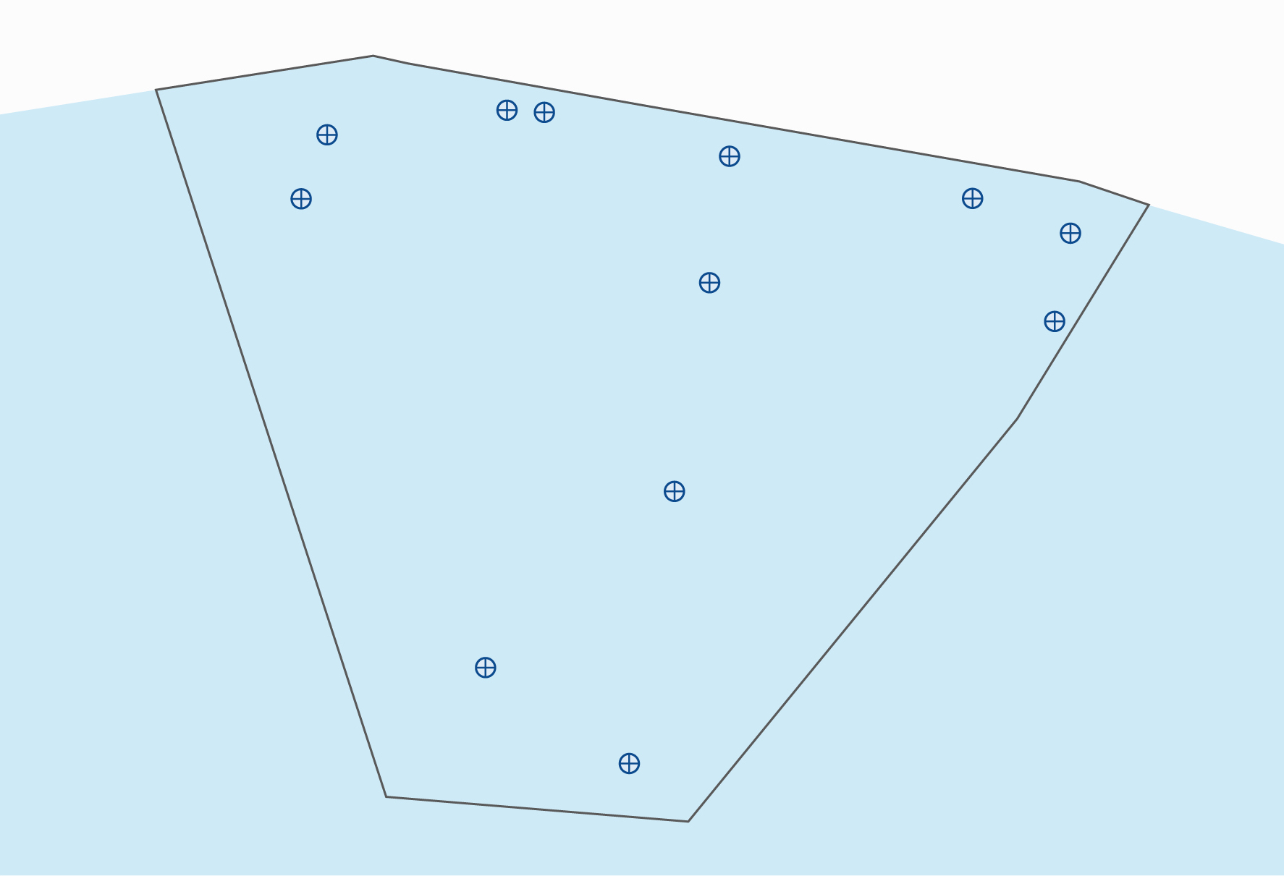
What Is a SWAC?
Surface-weighted average concentration
A surface-weighted average of sample data intended to estimate mean contaminant concentration over a specified spatial area (Kern, 2019)
Used for contaminated sediment and soil sites
Shoreline
400
900
700
3500
550
250
2500
650
150
200
Nearshore
Sediment Site
45
Mean = 826 µg/kg
SWAC = 555 µg/kg
65
Sediment sample location
µg/kg: microgram(s) per kilogram
Introduction
Notes:
Remedial Investigation data sets are typically spatially biased, with more samples closer to suspected sources.
Calculating a SWAC is a way to account for that bias.
In this example, the higher concentrations were measured closer to shore, where the samples are spaced more closely.
The mean (arithmetic average) concentration of the 12 samples is 826 µg/kg; however, the higher concentration samples closer to shore represent smaller areas than the lower concentration samples farther offshore. If the variable spacing is accounted for, the SWAC is 555 µg/kg.
It is a relatively simple concept that is very useful for optimizing sediment and soil remedies. It may not be obvious how it works based on the introduction section of this presentation but stick with me and we will work through it later using this example.
This presentation focuses more on sediment than on soil, but the same concepts apply to both.

Slide 6
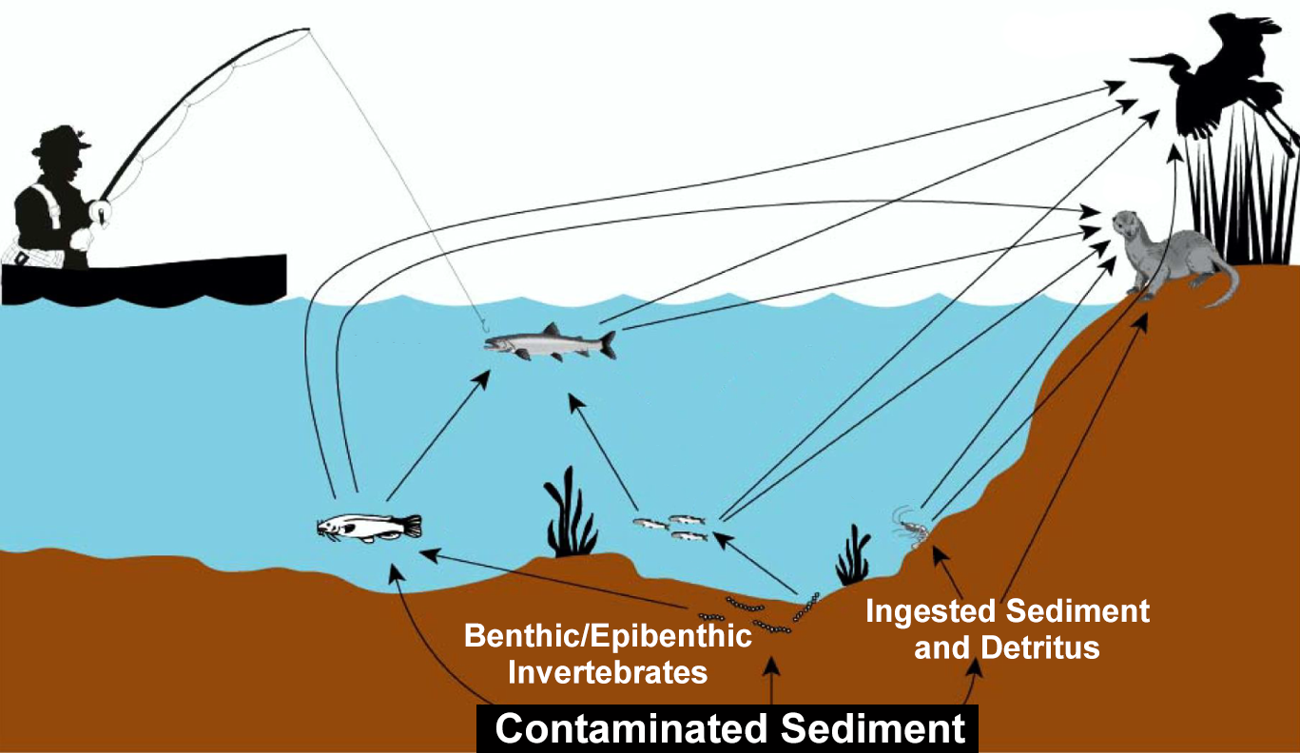
Why Are SWACs Used?
SWACs are typically used when comparing site data to remediation goals based on an average concentration
Individual sample results are typically used when comparing site data to remediation goals based on a point concentration
(Modified from US EPA 2005)
Introduction
Notes:
This is a typical conceptual site model for a contaminated sediment site. It shows how people and wildlife are exposed to contaminants in sediment.
SWACs are typically used at sites where unacceptable risks are from people or wildlife consuming fish or other organisms that move around. The SWAC represents an average exposure concentration.
Common contaminants that bioaccumulate in the tissues of these organisms include polychlorinated biphenyls, DDT and its breakdown products, and mercury.
In cases where the contaminants bioaccumulate and the receptors have a large home range, site data are typically compared to remediation goals on an average basis.
In cases where the contaminants cause acute toxicity or the receptor has a small home range, site data are typically compared to remediation goals on a point-by-point basis.

Slide 7
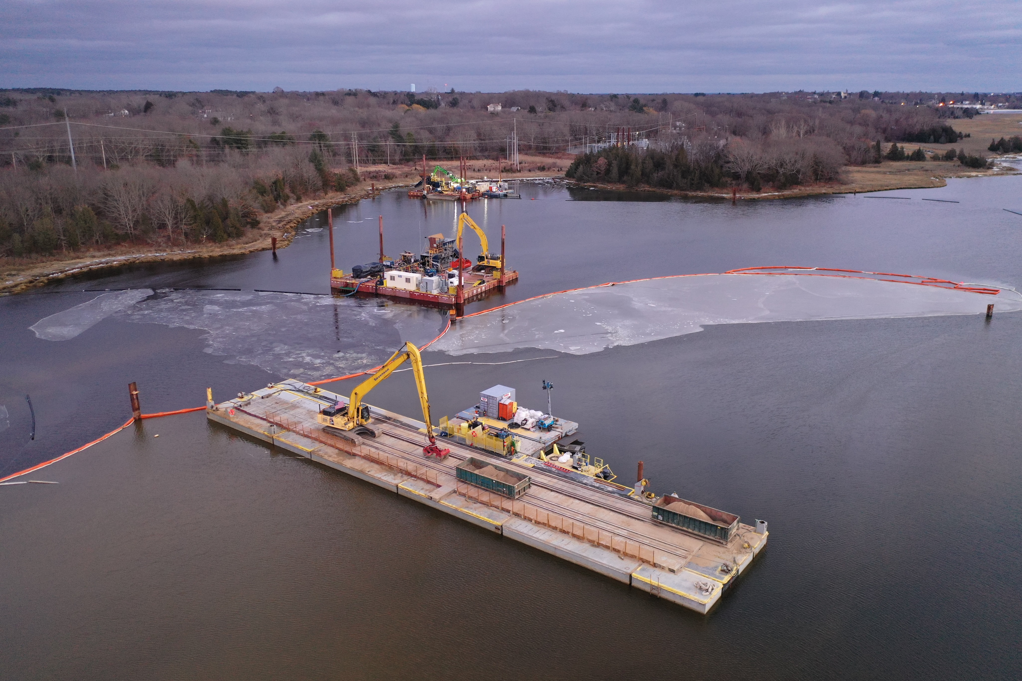
Why Is the SWAC Approach Important?
Remedies for contaminated sediment and soil sites can be complex and costly
A SWAC approach can:
Establish whether remedial action is necessary
Focus remediation on the highest risk areas
Accommodate operational constraints
Excavation
Dredging
Capping
(Smith et al. 2023)
Common sediment and soil remediation technologies
Introduction
Notes:
Contaminated sediment sites may have large areas affected by diffuse contamination that is difficult to remediate cost effectively.
A SWAC approach can help address some of the challenges commonly encountered on Navy sediment and soil sites.

Slide 8
SWAC-Related Terminology
PRG: Numeric remediation goal developed in an FS
RG: Numeric remediation goal memorialized in a ROD
RAL: Maximum concentration of a COC that can remain in sediment at any location
Remedial footprint: Area within a site targeted for active remediation (dredging or excavation, capping, in situ treatment)
KEY POINT
Other terms can be used, but minimize confusion by rigorously using consistent terminology in reports and presentations or consider including a glossary.
COC: contaminant of concern
FS: Feasibility Study
PRG: preliminary remediation goal
RAL: remedial action level
RG: remediation goal
ROD: Record of Decision
Introduction
Notes:
This slide defines the terminology that is used throughout this presentation.
It is important to always use consistent terminology when talking with partners, stakeholders, and regulators about using a SWAC approach to minimize unnecessary confusion and facilitate reaching consensus on a remedy.

Slide 9
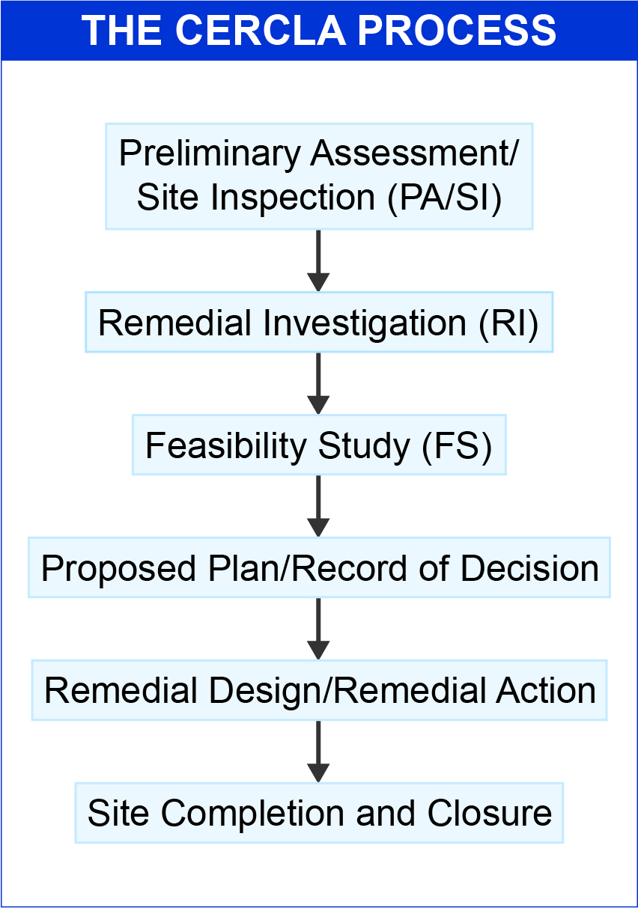
How and When Are SWACs Used?
To estimate exposure point concentrations for risk assessments
To identify, develop and optimize remedial footprints
To document risk management decisions
To assess compliance with or progress toward achieving RGs
CERCLA: Comprehensive Environmental Response, Compensation, and Liability Act of 1980
Introduction
Notes:
The left-hand side of the slide shows the standard progression of a project through the CERCLA process.
SWACs can be used at various stages of the process, but they are most commonly used to develop remedial footprints during the FS, which is the focus of this presentation.
Usually, project teams back into a SWAC approach in the FS using combined data sets from the RI (rather than designing RI sampling to support development of SWACs).

Slide 10
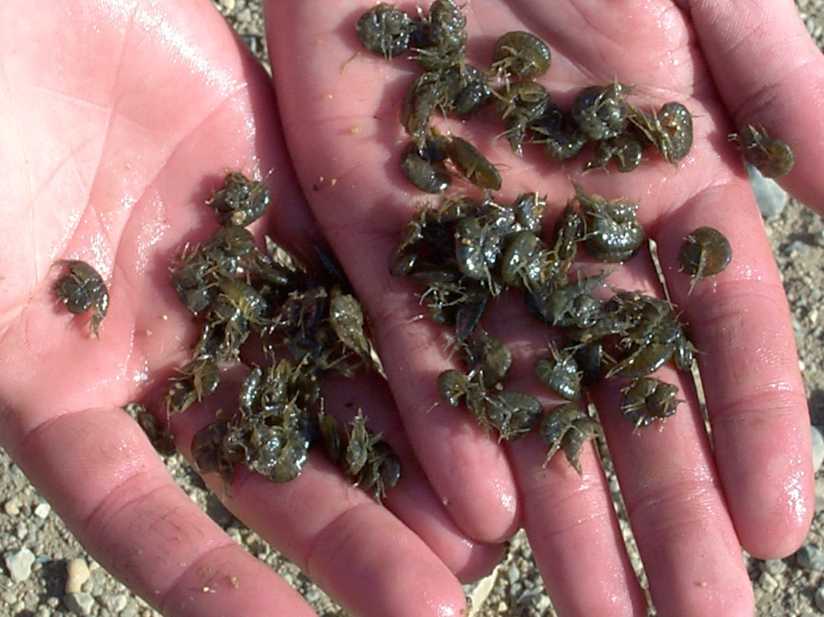
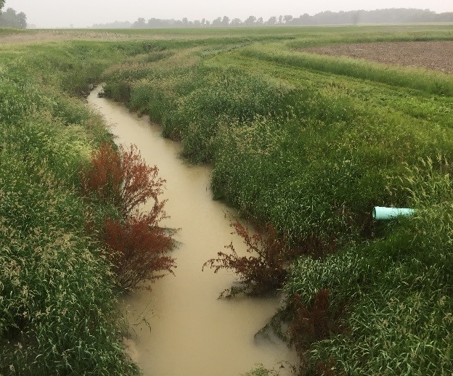
Where Are SWACs Not Used?
SWAC approach may not always be appropriate or warranted as in the following cases:
COCs cause acute effects
Site is relatively small
Site has localized and well-defined “hot spots”
(USGS 2023)
(USGS 2023)
Amphipods
Drainage Channel
Introduction
Notes:
A SWAC approach may not be necessary if the extent of remedial action needed is obvious.

Slide 11
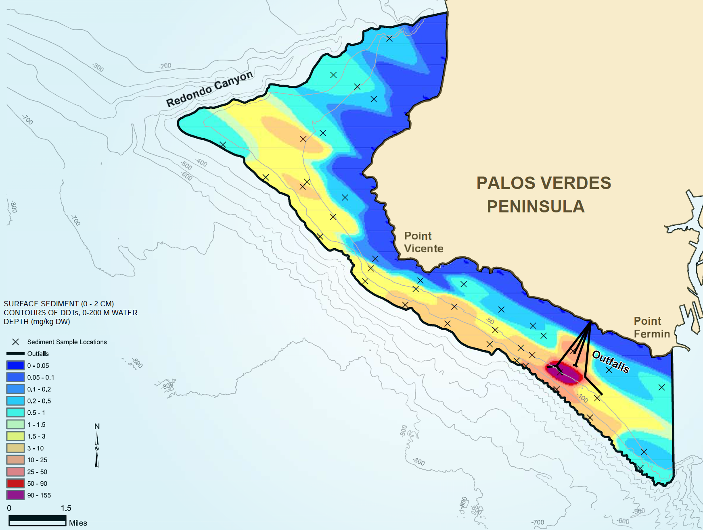
What Are Benefits to Using a SWAC Approach?
Reduces influence of sampling bias when calculating average concentrations
Interpolates COC concentrations in areas with no sampling data
Helps identify and focus remediation on areas with highest risk
Provides flexibility for optimizing remedial footprints
(US EPA et al. 2009)
cm: centimeter(s)
m: meter(s)
mg/kg: milligram(s) per kilogram
Introduction
Notes:
Samples collected for an RI are typically biased toward suspected source areas.
There are several ways to interpolate COC concentrations between sample locations, which we will discuss in the methodology section.
Remedial action will focus on the highest concentration areas, but how far does the remedy need to extend?
A SWAC approach can be used to address this question.

Slide 12
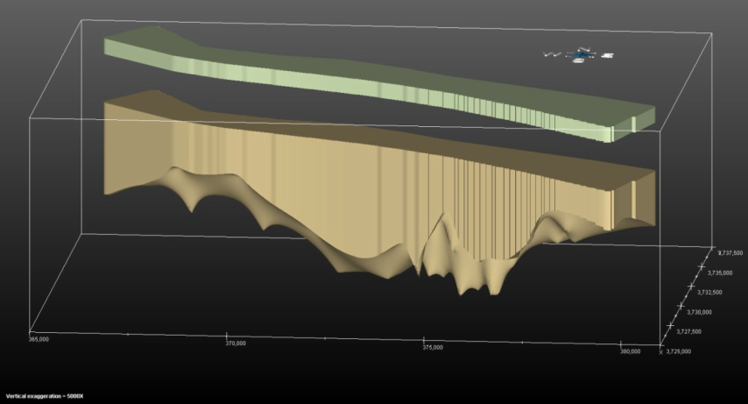
What Are Challenges to Using a SWAC Approach?
May be a perception that a SWAC approach is being used to avoid active remediation by including lower COC concentrations in the calculation
Depending on method, may not provide an estimate of uncertainty on mean concentration (e.g., 100 + 50 µg/kg)
SWACs are based on surface sediment only; subsurface contamination, if present, must also be addressed
(ICF and Sundance 2018)
SWAC is calculated for surface sediment or soil, but subsurface also may be contaminated
Introduction
Notes:
Project team may need to educate regulators/stakeholders who are unfamiliar with a SWAC approach to demonstrate that the remedial footprint would be protective and meet regulatory requirements; some may be uncomfortable with the idea of leaving any sediment with COC concentrations above the PRG in place.
The surface sediment interval is typically the top 6 inches (sometimes thicker or thinner). COC concentrations at many sediment sites are higher in deeper sediment than they are at the surface. I will address this later in the presentation.

Slide 13
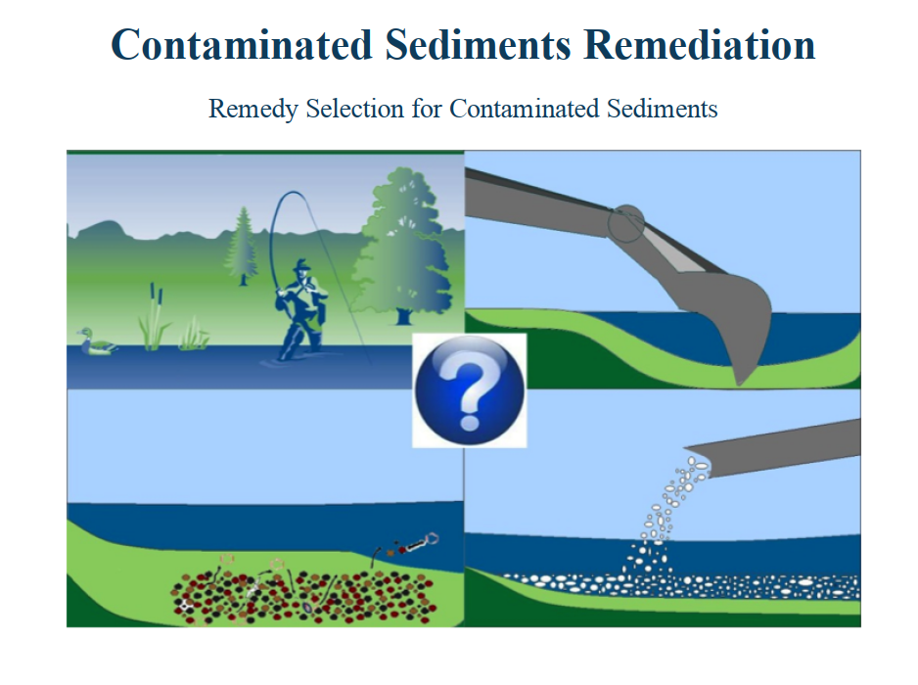
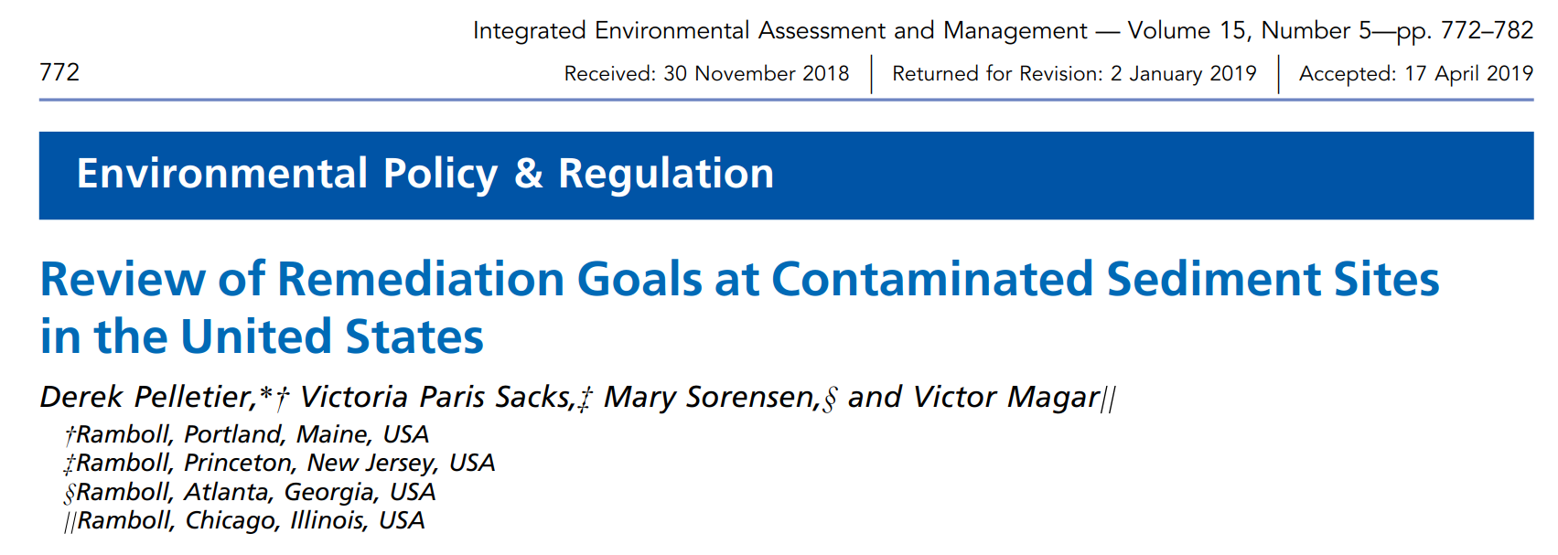
SWAC Guidance and Resources
NAVFAC EXWC (forthcoming)
ITRC (2014) Section 6
Kern (2019)
ITRC (2016)
Pelletier et al. (2019)
ITRC: Interstate Technology and Regulatory Council
Introduction
Notes:
US EPA has not issued guidance related to SWACs.
The other resources shown on this slide address various aspects of developing and using SWACs.

Slide 14
Presentation Overview
Introduction
SWAC Methodology
Case Study #1 – MCB Quantico
Case Study #2 – Portland Harbor
Other Site Examples
Wrap-up
Notes:
Any questions or comments before moving on to the next section?
The next section will proceed step-by-step through SWAC methodology, highlighting factors that should be considered and the flexibility in the process.

Slide 15
SWAC Methodology Overview
Establish area over which SWAC will be calculated
Select SWAC method
Calculate SWAC(s) and compare to PRG(s)
Develop remedial footprint to reduce SWAC below PRG(s) or optimize remedial footprint to most cost-effectively achieve risk reduction
Calculate post-remedy SWAC to verify that RG has been achieved or, for monitored natural recovery, monitor progress toward achieving RG
KEY POINT
If remedial footprints are developed for more than one COC, then combined footprint must be used for developing remedial alternatives.
SWAC Methodology
Notes:
(Animation) – these are the five steps that we will cover in this section.

Slide 16
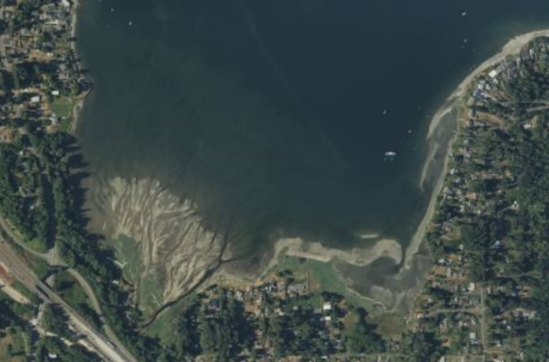
Establishing SWAC Area
Factors to consider when establishing area(s) over which SWAC will be calculated
Site boundary
Geographic boundaries
CSM (e.g., exposure area for target receptor)
Data distribution
Subtidal
Intertidal
(Source: Esri, Maxar, Earthstar Geographics, and the GIS User Community)
KEY POINT
Consider discussing area over which SWAC will be calculated with regulatory agencies prior to analysis.
CSM: conceptual site model
SWAC Methodology
Notes:
Sometimes the area over which the SWAC should be calculated is obvious, but sometimes it is not.
A site boundary may be an administrative boundary.
Geographic boundaries may include roads, bridges, confluences.
The CSM should be considered when establishing the SWAC area; the exposure area for the target receptor may be larger than the site.
Should all available site data be incorporated into the SWAC, or should some locations be excluded?

Slide 17
Selecting a SWAC Method
Factors to consider
Site size and complexity
Uncertainty – is answer obvious, or will method selection affect outcome
Technical factors (e.g., data density and distribution)
Other considerations (cost, schedule, regulator input)
KEY POINT
Consult with experts in geospatial analysis when selecting a SWAC method.
SWAC Methodology
Notes:
A range of SWAC methods is available, from simple to complex.
Stick with simple methods if the answer is obvious.
Exploratory data analysis should be considered if the selection of the SWAC method affects the outcome.

Slide 18
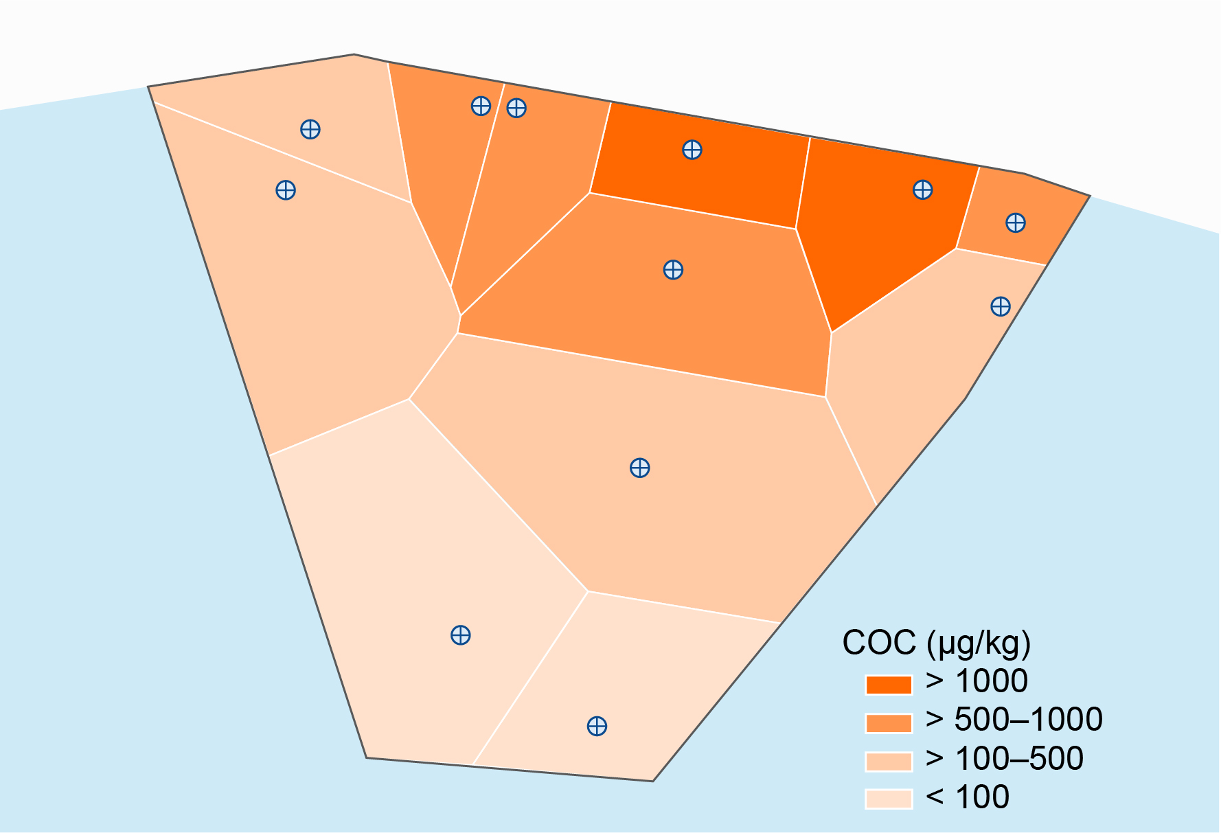
Weighted Polygons – Definition
Thiessen polygon boundaries define area that is closest to each point relative to all other points
Boundaries are mathematically defined by perpendicular bisectors of lines between all points
Shoreline
Nearshore
Sediment Site
SWAC Methodology
Notes:
This is the same example that was shown on the introduction slide.
The edges of Thiessen polygons are halfway between adjacent sampling points.
The polygons are color-coded by concentration.
The higher concentration samples nearshore represent a smaller area than the lower-concentration samples farther from shore.

Slide 19
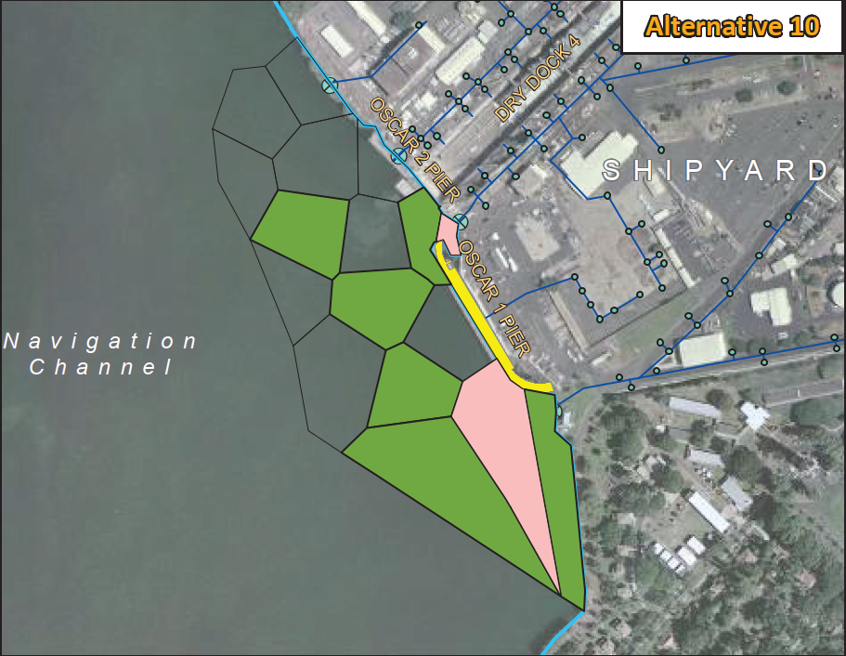
Weighted Polygons – Advantages and Limitations
Advantages
Network easy to construct in GIS
Easy to understand
Limitations
Based solely on sample distribution
No estimate of uncertainty
(Navy 2016)
GIS: geographic information system
SWAC Methodology
Notes:
This is an example of a Thiessen polygon network from one of the Pearl Harbor Sediment Decision Units.
The assumed COC distribution based on Thiessen polygons may not reflect the CSM (what you would expect to see based on fate and transport processes).

Slide 20
Weighted Polygons – How to Develop a SWAC
A
×
B
=
C
COC (µg/kg) | Percent of Total Area | Area-adjusted Concentration (µg/kg)
3,500 | 4.5% | 157
2,500 | 5.6% | 139
900 | 3.3% | 29.9
700 | 4.4% | 31.1
650 | 11.4% | 73.9
550 | 2.0% | 11.0
400 | 4.5% | 17.9
250 | 13.2% | 33.0
200 | 19.4% | 38.8
150 | 7.8% | 11.7
65 | 7.8% | 5.06
45 | 16.1% | 7.26
Total | 100% | 555
400
Shoreline
900
700
3500
550
250
2500
650
150
200
45
65
Sum of Area-adjusted Concentrations
SWAC Methodology
Notes:
The next four slides show how to develop a SWAC and a remedial footprint using Thiessen polygons.
The sample concentrations are ordered from high to low in this table.
Multiply column A by Column B (as a fraction), and then sum the area-adjusted concentrations to determine the SWAC.
There are other mathematically equivalent ways to calculate the SWAC.
Important point – spell out the approach and show the formulas in the FS report so that the calculations are transparent. Make it easy for the reviewers to understand the approach.

Slide 21
Weighted Polygons – How to Develop a Remedial Footprint (1/3)
A
×
B
=
C
COC (µg/kg) | Percent of Total Area | Area-adjusted Concentration (µg/kg)
0.05 | 4.5% | 0.002
2,500 | 5.6% | 139
900 | 3.3% | 29.9
700 | 4.4% | 31.1
650 | 11.4% | 73.9
550 | 2.0% | 11.0
400 | 4.5% | 17.9
250 | 13.2% | 33.0
200 | 19.4% | 38.8
150 | 7.8% | 11.7
65 | 7.8% | 5.06
45 | 16.1% | 7.26
Total | 100% | 399
400
Shoreline
900
700
3500
550
250
2500
650
150
200
45
65
PRG = 250 µg/kg
SWAC Methodology
Notes:
A typical approach is to start with the highest concentration polygon and mathematically “remediate” it by substituting the sample concentration with an assumed post-remediation concentration.
Need to determine the post-remediation replacement value; it may be zero, or a detection limit, or half the detection limit
Recalculate the SWAC and compare it to the PRG; in this case, the SWAC still exceeds the PRG.
Any questions so far?

Slide 22
Weighted Polygons – How to Develop a Remedial Footprint (2/3)
A
×
B
=
C
COC (µg/kg) | Percent of Total Area | Area-adjusted Concentration (µg/kg)
0.05 | 4.5% | 0.002
0.05 | 5.6% | 0.003
900 | 3.3% | 29.9
700 | 4.4% | 31.1
650 | 11.4% | 73.9
550 | 2.0% | 11.0
400 | 4.5% | 17.9
250 | 13.2% | 33.0
200 | 19.4% | 38.8
150 | 7.8% | 11.7
65 | 7.8% | 5.06
45 | 16.1% | 7.26
Total | 100% | 260
400
Shoreline
900
700
3500
550
250
2500
650
150
200
45
65
PRG = 250 µg/kg
SWAC Methodology
Notes:
Repeat the procedure by “remediating” the polygon with the second highest concentration.
In this example, the recalculated SWAC still exceeds the PRG.

Slide 23
Weighted Polygons – How to Develop a Remedial Footprint (3/3)
A
×
B
=
C
COC (µg/kg) | Percent of Total Area | Area-adjusted Concentration (µg/kg)
0.05 | 4.5% | 0.002
0.05 | 5.6% | 0.003
0.05 | 3.3% | 0.002
700 | 4.4% | 31.1
650 | 11.4% | 73.9
550 | 2.0% | 11.0
400 | 4.5% | 17.9
250 | 13.2% | 33.0
200 | 19.4% | 38.8
150 | 7.8% | 11.7
65 | 7.8% | 5.06
45 | 16.1% | 7.26
Total | 100% | 230
400
Shoreline
900
700
3500
550
250
2500
650
150
200
45
65
RAL = 700 µg/kg
PRG = 250 µg/kg
>: greater than
<: less than
SWAC Methodology
Notes:
Repeat the procedure by “remediating” the polygon with the third highest concentration.
After this step, the recalculated SWAC is below the PRG.
Every polygon with a concentration exceeding 700 µg/kg has been remediated; thus, the RAL is 700 µg/kg.
Four polygons with COC concentrations exceeding the PRG remain in place, but the SWAC is below the PRG.
Usually polygons are targeted for remediation from highest to lowest concentration, but other polygons can be substituted if necessary to protect high-value habitat or avoid specific operational areas.

Slide 24
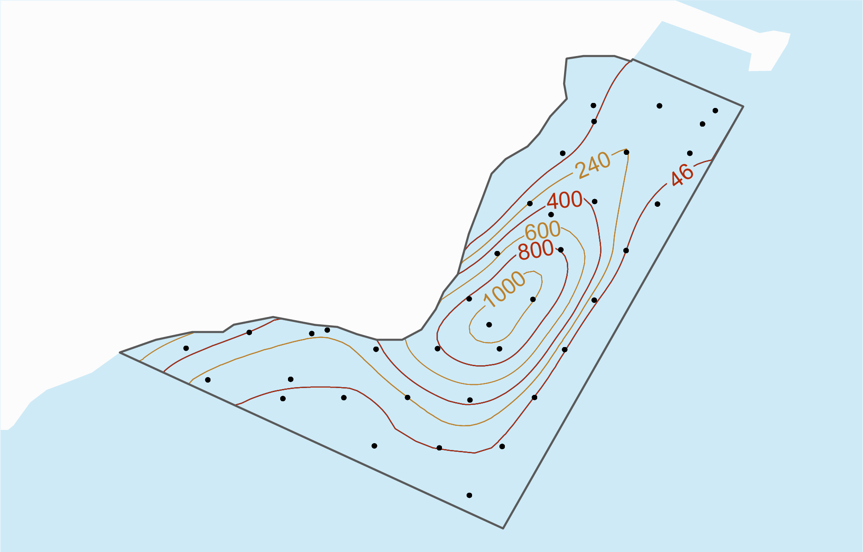
Interpolations – Definition
Legend
Surrounding sample results are used to estimate COC concentrations at unsampled points
A range of interpolation methods is available, from simple to complex:
Natural Neighbor
Inverse distance weighting
Kriging
Others
Upland Area
Nearshore Area
(Modified from Battelle et al. 2007)
SWAC Methodology
Notes:
Another approach is to use an interpolation to predict COC concentrations in unsampled areas.
This presentation will not go into the details of the different interpolation methods, but you can reference the EXWC SWAC guide or other resources for more detail.
Different methods require different levels of user input.
Consider engaging a geospatial analysis Subject Matter Expert.
Interpolation is performed in a GIS or other software programs.

Slide 25
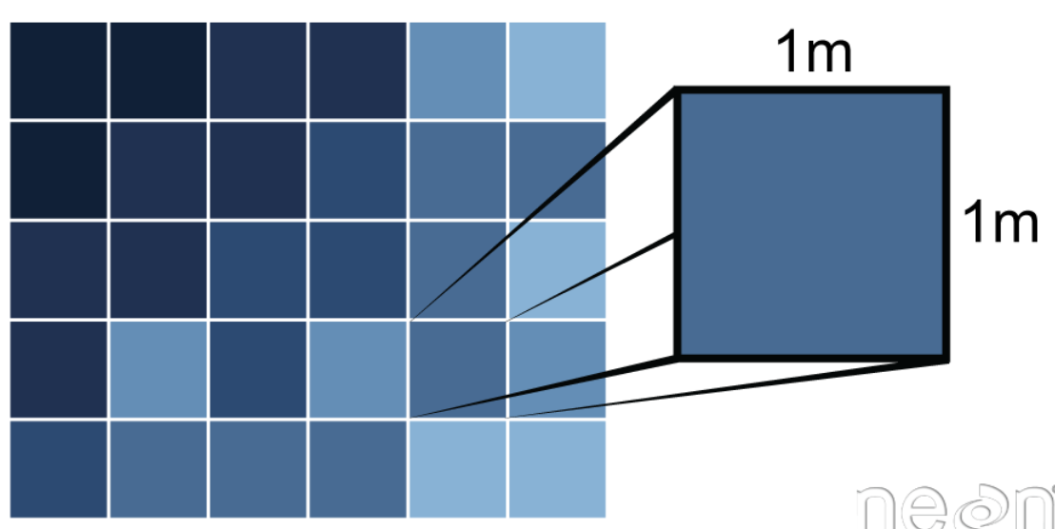
Interpolation Grids
Interpolation using a computer program produces a grid with a measured or predicted concentration associated with each grid cell
(Wasser and Goulden 2021)
m: meter(s)
SWAC Methodology
Notes:
Interpolations provide a grid with a measured or predicted concentration assigned to each grid cell.
Data can be displayed using contour lines or color scales.
SWAC is calculated by averaging the values in the grid cells within a specified area.

Slide 26
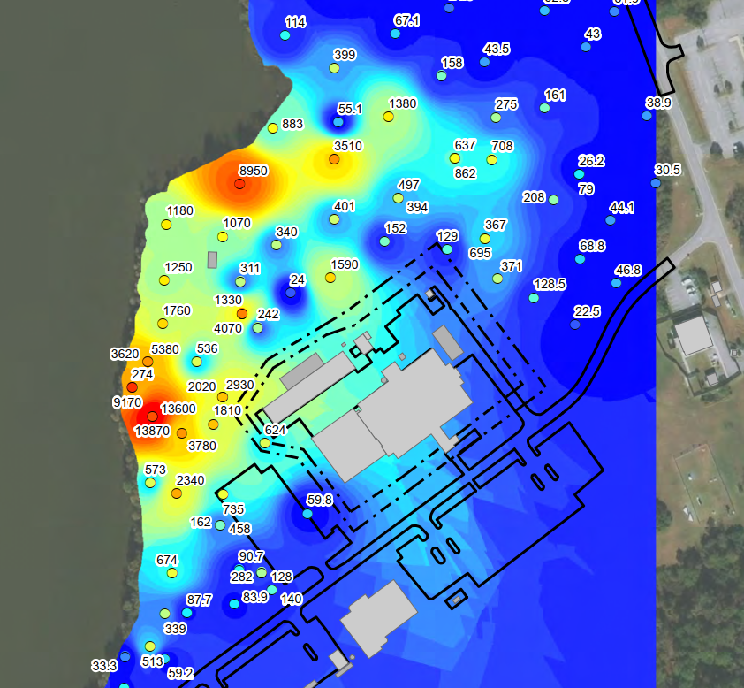
Interpolations – Advantages and Limitations
Advantages
Considers data from nearby locations
More complex methods consider spatial trends in data; can provide uncertainty estimates
Limitations
Requires more specialized expertise
May provide anomalous results
(CH2M 2021)
SWAC Methodology
Notes:
Interpolations may provide a more reasonable representation of contaminant distribution than Thiessen polygons; however, some reviewers may perceive the representation as “true.”

Slide 27
Interpolations – How to Develop a Remedial Footprint
DDx Contour (µg/kg) | Total Area Inside Contour (acres) | Post-remediation SWAC (µg/kg)
1,000 | 1.4 | 238
800 | 5.0 | 182
600 | 9.0 | 133
400 | 14.4 | 86.7
240 | 21.5 | 49.1
46 | 37.4 | 9.7
Total | 56.3 | Not applicable
COC concentration within a remediated
contour replaced with a value of 9 µg/kg.
(Modified from Battelle et al. 2007)
PRGs:
Lowest observed adverse effects level – 240 µg/kg
No observed adverse effects level – 46 µg/kg
Remediating within 800 µg/kg contour would achieve a SWAC midway between two PRGs
DDx: dichlorodiphenyltrichloroethane and its derivatives
SWAC Methodology
Notes:
In this example, the project team is considering upper-bound and lower-bound PRGs. The upper bound is not conservative enough, but the lower bound may be too conservative. The goal is to develop a remedial footprint that falls between the two PRGs.
The method for estimating post-remediation SWACs is the same as it is for Thiessen polygons, except in this case all sediment within a given concentration contour is mathematically remediated.
Remediating to a RAL of 1,000 yields a post-remediation SWAC of 238 µg/kg, which is just below the upper bound PRG.
Remediating to a RAL of 800 µg/kg yields a post-remediation SWAC of 182 µg/kg, which is closer to the middle of the range.
This is an example of how the risk management decision can consider cost versus risk reduction; the next 3 slides address this in more detail.

Slide 28
Comparing SWACs to PRG Ranges
Highest
concentration
PRGs
PRGs are developed to address each RAO and can be based on
Site-specific RBCs
Background
ARARs (e.g., Washington State)
Ecological RBC
Fish-eating Bird
Human Health RBC
Recreational Fisher
Background
Human Health RBC
Subsistence Fisher
ARARs: applicable or relevant and appropriate requirements
RAO: remedial action objective
RBC: risk-based concentration
Lowest
concentration
SWAC Methodology
Notes:
This slide is a refresher on how PRGs are typically developed for sediment sites (or is new to some of you).
These sites often have more than none RAO.
Navy Sediment Policy dictates that the RGs cannot be set below background levels; in many cases, RBCs based on protection of subsistence fishers is below the background level in urban waterways; the PRG in these cases defaults to background.
The following slides will show how to compare SWACs to ranges of PRGs.

Slide 29
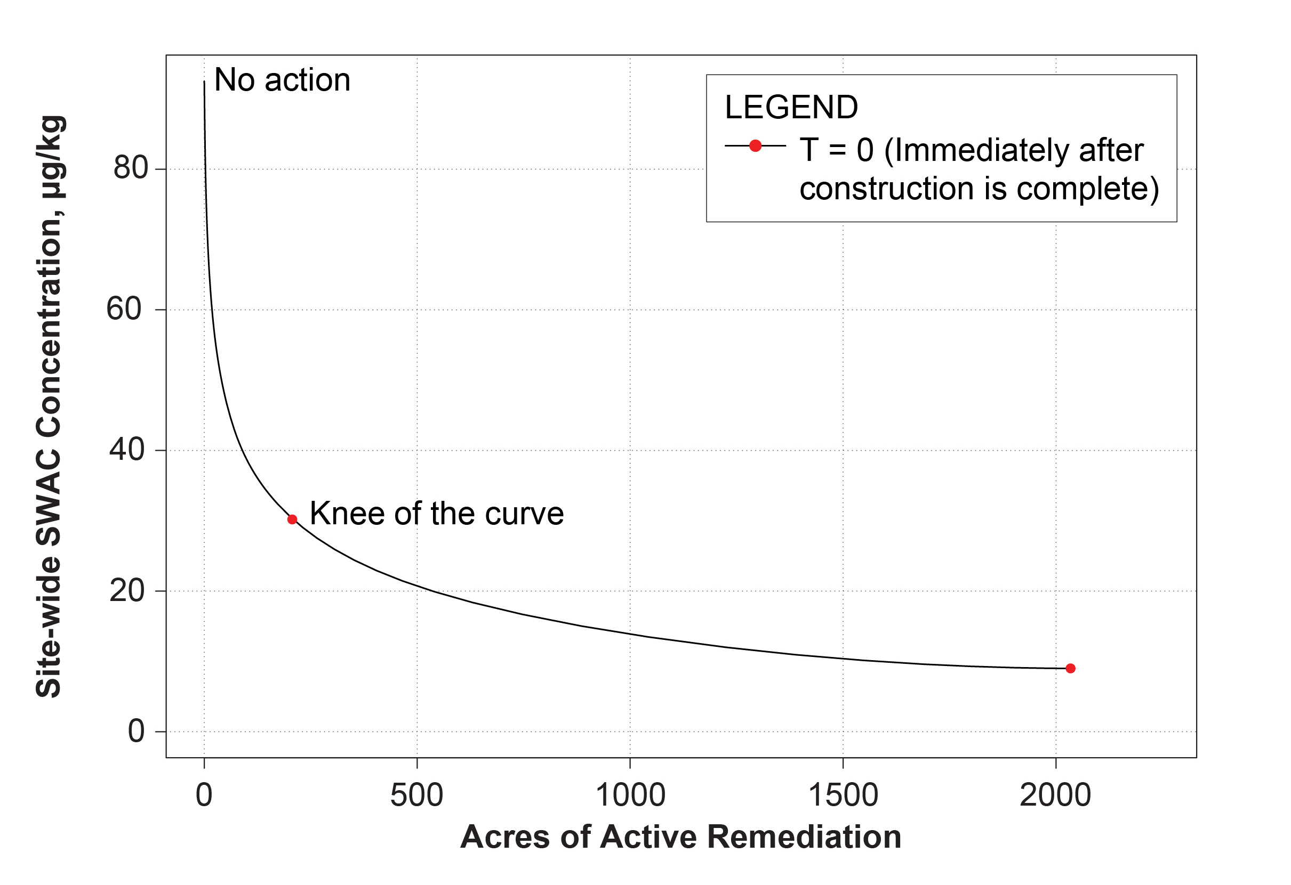
How to Optimize a Remedial Footprint
Selecting a RAL that corresponds with “knee of the curve” provides most bang for the buck
For some sites, a combination of active remediation and monitored natural recovery may be most cost effective for achieving PRG
Background-based PRG
(Modified from US EPA 2016)
SWAC Methodology
Notes:
This plot shows SWAC (y-axis) versus acres remediated (x-axis).
The shape of this curve corresponds to the typical sediment site that has hot spots of higher contaminant levels and broader areas of low-level contamination.
The “knee of the curve” corresponds to the point where increasing larger areas must be remediated to reduce the SWAC.
Key point is that remediating to achieve SWACs that are below the knee-of-the-curve may not be cost effective.

Slide 30
How to Use SWACs for Risk Management
Different RALs can be selected to achieve different risk management goals
Ecological PRG Fish-eating Bird
Human Health PRG Recreational Fisher
Background-based PRG
(Modified from US EPA 2016)
SWAC Methodology
Notes:
In this example, selecting a RAL that corresponds with the knee of the curve would protect fish-eating birds but not fish-eating humans.
Selecting a RAL below the knee of the curve would also protect recreational fishers. Remediation would cost more but would achieve RAOs more quickly.
To achieve a background-based PRG, it may be more cost effective to reduce the SWAC to some level above the PRG and then rely on MNR to achieve the PRG.

Slide 31
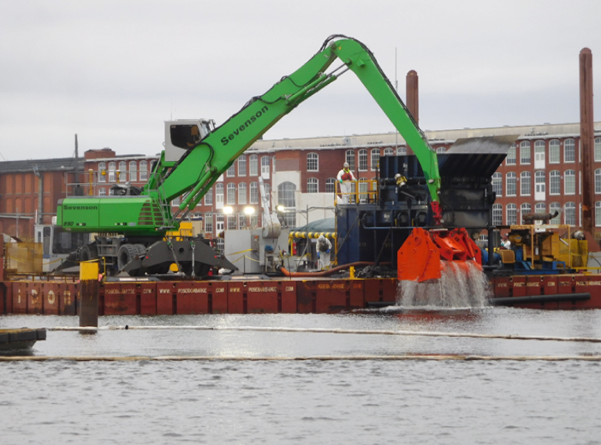
Interactive Exercise
Your project team has just completed the first dredging pass for a sediment remediation project. The post-remedy SWAC based on confirmatory sampling data indicates that the remediation goal has not yet been achieved.
Which Dredge Management Units do you recommend redredging?
(Jacobs 2018)
SWAC Methodology
Notes:
You will need to mathematically dredge the DMUs shown on the next slide and then recalculate the SWAC until the RG has been achieved.
You can use the calculator on your phone.

Slide 32
Interactive Exercise Details
Remediation Goal = 8 µg/kg
Assumed replacement value = 0.5 µg/kg
DMU | Size (acres) | Percent of Total Area | Post-dredge Concentration (µg/kg) | Area-adjusted Concentration (µg/kg)
1 | 0.6 | 5.2% | 7.0 | 0.36
2 | 0.6 | 5.2% | 7.2 | 0.37
3 | 0.7 | 6.0% | 13 | 0.78
4 | 1.0 | 8.6% | 15 | 1.29
5 | 0.8 | 6.9% | 20 | 1.38
6 | 0.8 | 6.9% | 4.5 | 0.31
7 | 0.4 | 3.4% | 27 | 0.93
8 | 0.8 | 6.9% | 4.3 | 0.30
9 | 1.1 | 9.5% | 10 | 0.95
10 | 1.3 | 11% | 12 | 1.34
11 | 1.3 | 11% | 9.3 | 1.04
12 | 2.2 | 19% | 7.0 | 1.33
 |  |  | SWAC | 10.4
(Modified from US EPA 2010)
DMU: dredge management unit
SWAC Methodology
Notes:
There is more than one answer to this problem. In the real world, you would consider both concentration and area to optimize the redredging plan. Spreadsheet tools can be used to support decision-making.

Slide 33
Presentation Overview
Introduction
SWAC Methodology
Case Study #1 – MCB Quantico
Case Study #2 – Portland Harbor
Other Site Examples
Wrap-up
Notes:
Revisit where we are on the agenda after lunch.

Slide 34
How to Address Subsurface Contamination
For areas within remedial footprint, define vertical extent using RALs
For areas outside remedial footprint (COC concentrations are below RAL in surface sediment but above RAL in subsurface sediment)
Approach depends on CSM and other site-specific considerations
If subsurface contamination does not pose a risk and is not expected to be exposed in future, consider institutional controls
1
2
> RAL
< RAL
< RAL
> RAL
KEY POINT
Don’t forget to consider buried contamination when doing a SWAC analysis.
SWAC Methodology
Notes:
At contaminated sediment sites, the highest COC concentrations from historical discharges are often buried and may not pose a risk.

Slide 35
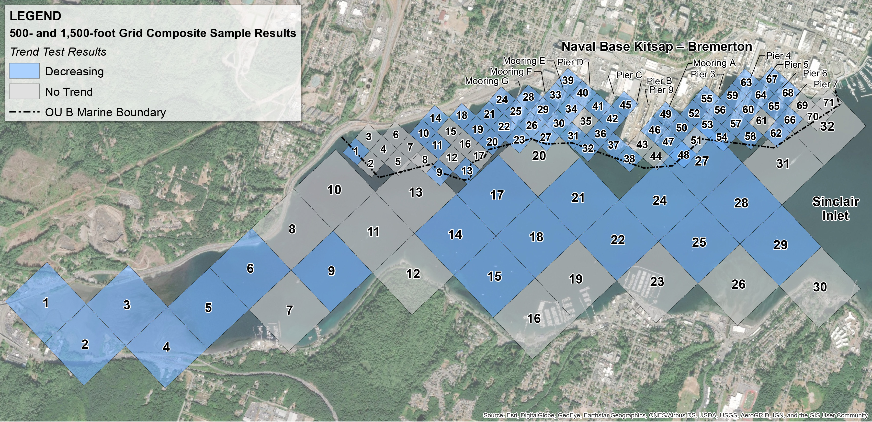
Using a SWAC to Assess Monitored Natural Recovery
Average PCB concentrations calculated separately for nearshore and offshore areas
Trends based on 7 sample events over 15 years
(CH2M 2020)
PCB: polychlorinated biphenyl
SWAC Methodology
Notes:
I have a few more slides showing how SWACs can be used for other purposes before moving into the case studies.
This example is from the Bremerton Naval Complex.
A dredging remedy was performed to remove the highest PCB concentrations, followed by MNR to reduce concentrations below the RG.
MNR relies on ongoing deposition of relatively cleaner sediment to reduce surface sediment COC concentrations.
In this case, a grid-based sample design was used for LTM; therefore, each result is equally weighted in the SWAC calculation.
The SWACs are compared to the RG and the trends are used to monitor the progress of MNR.

Slide 36
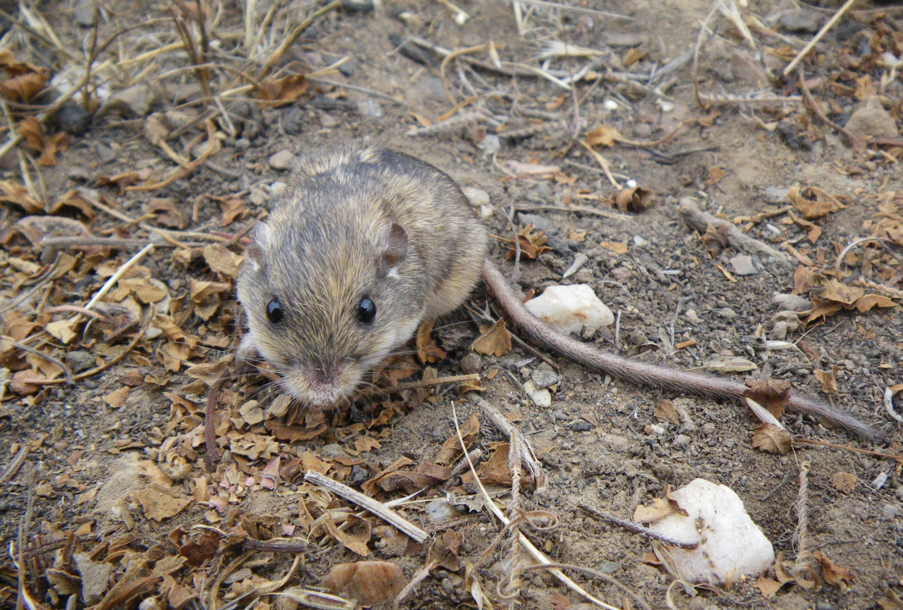
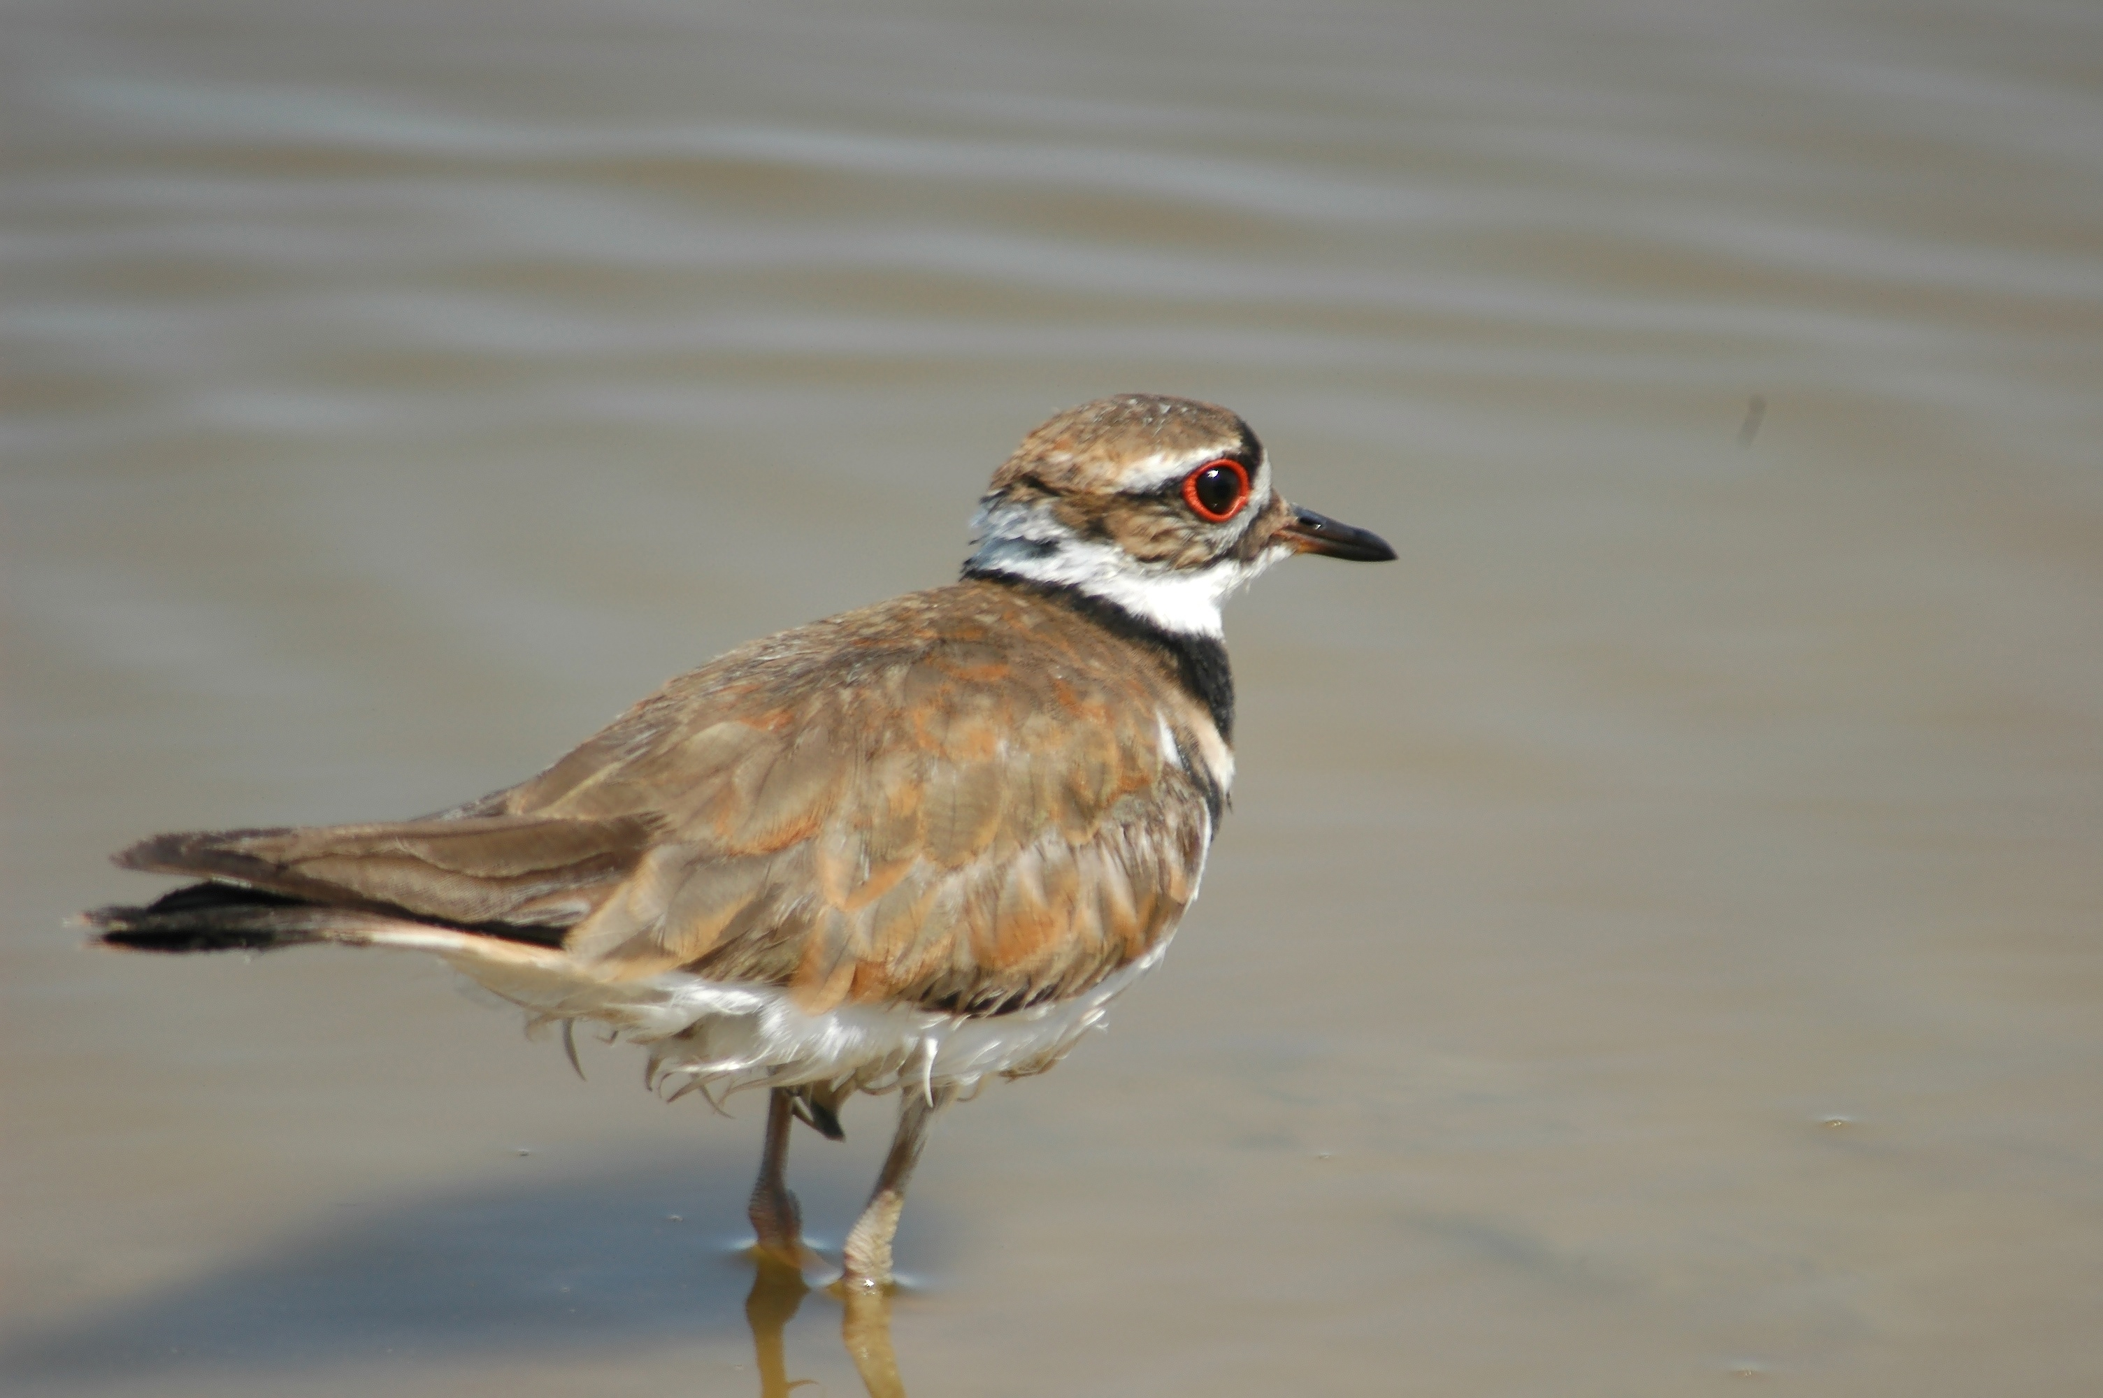
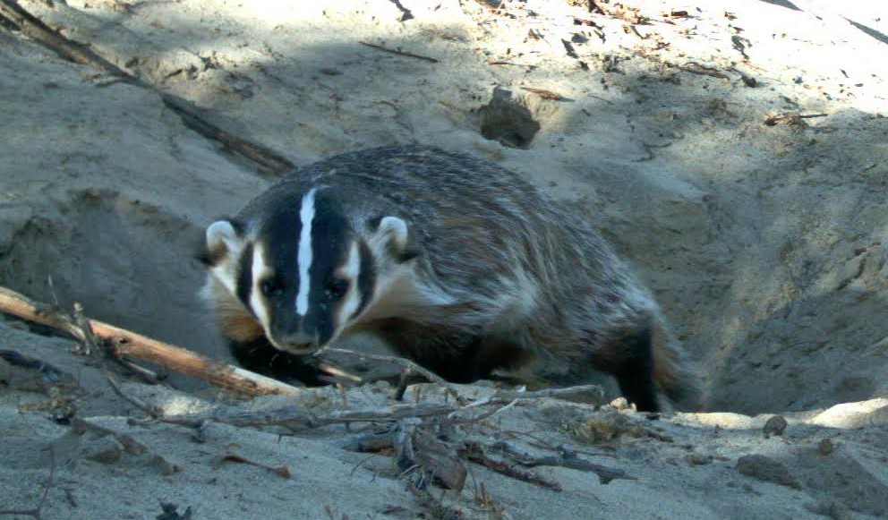
Using “Moving Windows” to Estimate Risk
Exposure concentrations in ecological risk assessments are typically sitewide averages
Sitewide average concentration may not be realistic or sufficiently precise
Goal of “moving windows” approach is to match averaging scale to home range of species of interest
Deer mouse
Grasshopper mouse
Killdeer
Badger
(USGS 2023)
(USGS 2023)
(USGS 2023)
(USGS 2023)
0.5
6
20
250
Home Range (acres)
SWAC Methodology
Notes:
This is an example of how to use SWACs in ecological risk assessment.

Slide 37
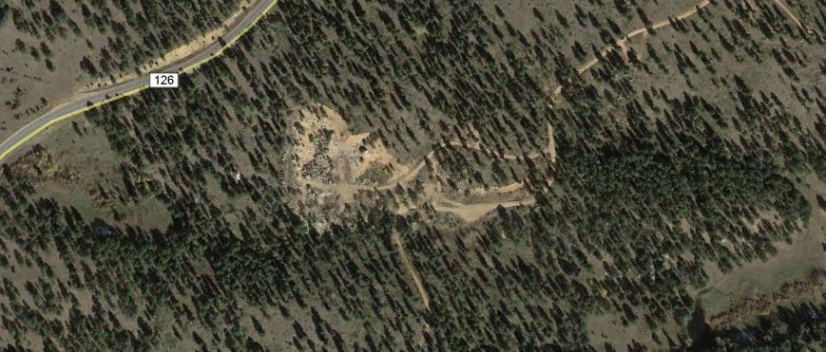
Moving Windows Procedure
Create COC concentration map in GIS: import COC concentration and spatial data into ArcMap and interpolate concentrations between sample points
Perform geospatial analysis: incrementally move a circle the size of the home range (window) across map and calculate a SWAC within each window
Grasshopper mouse
6-acre home range
(USGS 2023)
(Easterly et al. 2017)
SWAC Methodology
Notes:
The COC concentration distribution map is not shown here.
The SWAC is calculated by averaging the grid cell concentrations from the interpolation within each of the circular windows.
This animation shows how the circles overlap, with a new SWAC calculated for each window.
In reality, the windows are more closely spaced.

Slide 38
Moving Window Results
SWAC at center of each moving window is displayed
Points/colors can represent COC concentrations or hazard quotients
Model can be used to evaluate remediation scenarios that balance risk, habitat loss, and cost of remediation or account for site operational needs
Center of each 6-acre home range; warmer colors represent higher concentration/risk
(Easterly et al. 2017)
SWAC Methodology
Notes:
The rationale for a selected remedy can include statements like “this remedy will protect XX% of the receptor…”

Slide 39
Presentation Overview
Introduction
SWAC Methodology
Case Study #1 – MCB Quantico
Case Study #2 – Portland Harbor
Other Site Examples
Wrap-up

Slide 40
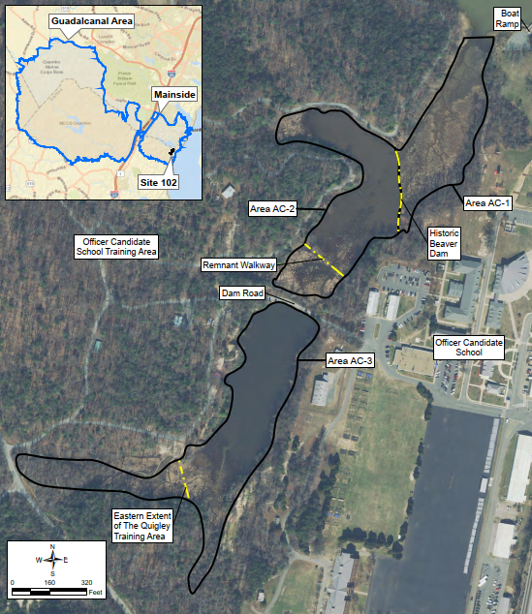
MCB Quantico Site 102 – Site Setting
Shallow ponds and wetlands
16.7-acre site divided into three areas based on geography (AC-1, AC-2, AC-3)
No recreational fishing
Unacceptable ecological risk from exposure to DDT in sediment
Officer Candidate School training area to west; active year-round except for December and mid-March to mid-May
Area AC-3 includes portion of “The Quigley,” a highly valued training area
AC-1
AC-2
AC-3
(NAVFAC 2021)
DDT: dichlorodiphenyltrichloroethane
Case Study #1 – MCB Quantico
Notes:
Of the two case studies, this one is more representative of a typical Navy soil or sediment site problem.
A beaver dam is the geographic division between AC-1 and AC-2, and a road with a culvert is the division between AC-2 and AC-3.
The very short window for conducting remediation is an operational constraint.
Base personnel advised the project team to avoid invasive work in The Quigley.

Slide 41
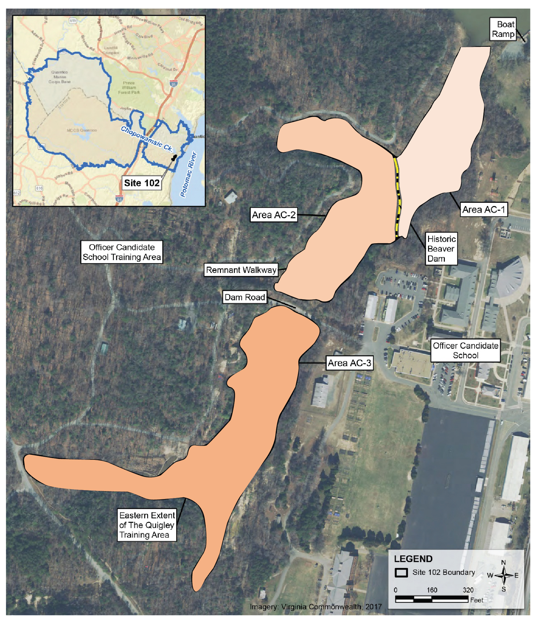
MCB Quantico Site 102 – SWAC Areas
RAOs reduce risk to insectivorous and piscivorous birds, piscivorous mammals, and resident fish from food-chain exposure to DDx in sediments
Subareas AC-1, AC-2, and AC-3 have different bioavailability characteristics and thus different PRGs
AC-1
AC-2
AC-3
(NAVFAC 2021)
Case Study #1 – MCB Quantico
Notes:
The TOC content of the sediment influences the bioavailability of the DDT.
The PRGs were calculating using TOC and lipid data from samples collected within each sub-area; thus, the PRGs are different in each area.

Slide 42
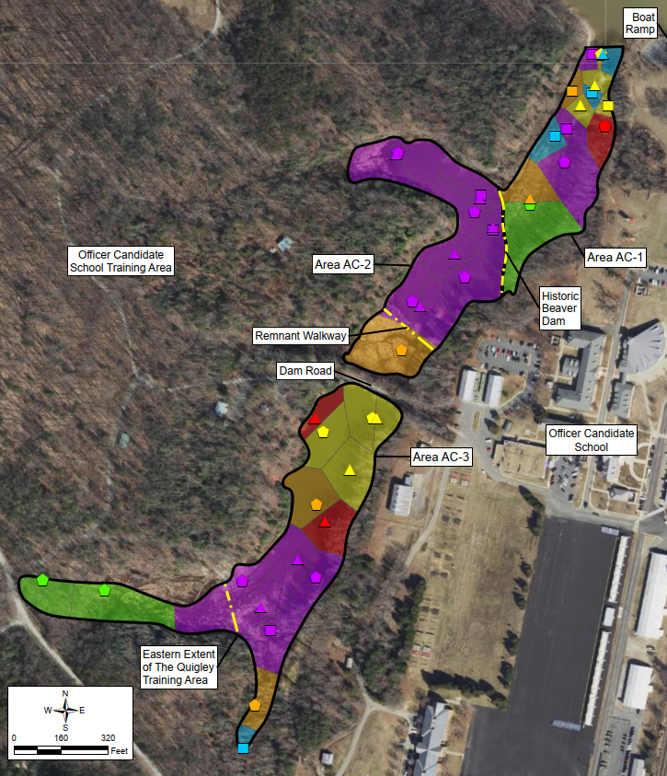
MCB Quantico Site 102 – SWAC Method
Thiessen polygon method was used to calculate SWACs:
Site was divided into three subareas based on geographic boundaries; each subarea was relatively small
High-concentration areas were well-defined
Legend
Total DDx (µg/kg dry weight)
0–200
200–400
400–600
600–800
800–1000
>1000
(NAVFAC 2021)
Case Study #1 – MCB Quantico
Notes:
Other more complex interpolation methods were not considered because the “answer” was obvious.

Slide 43
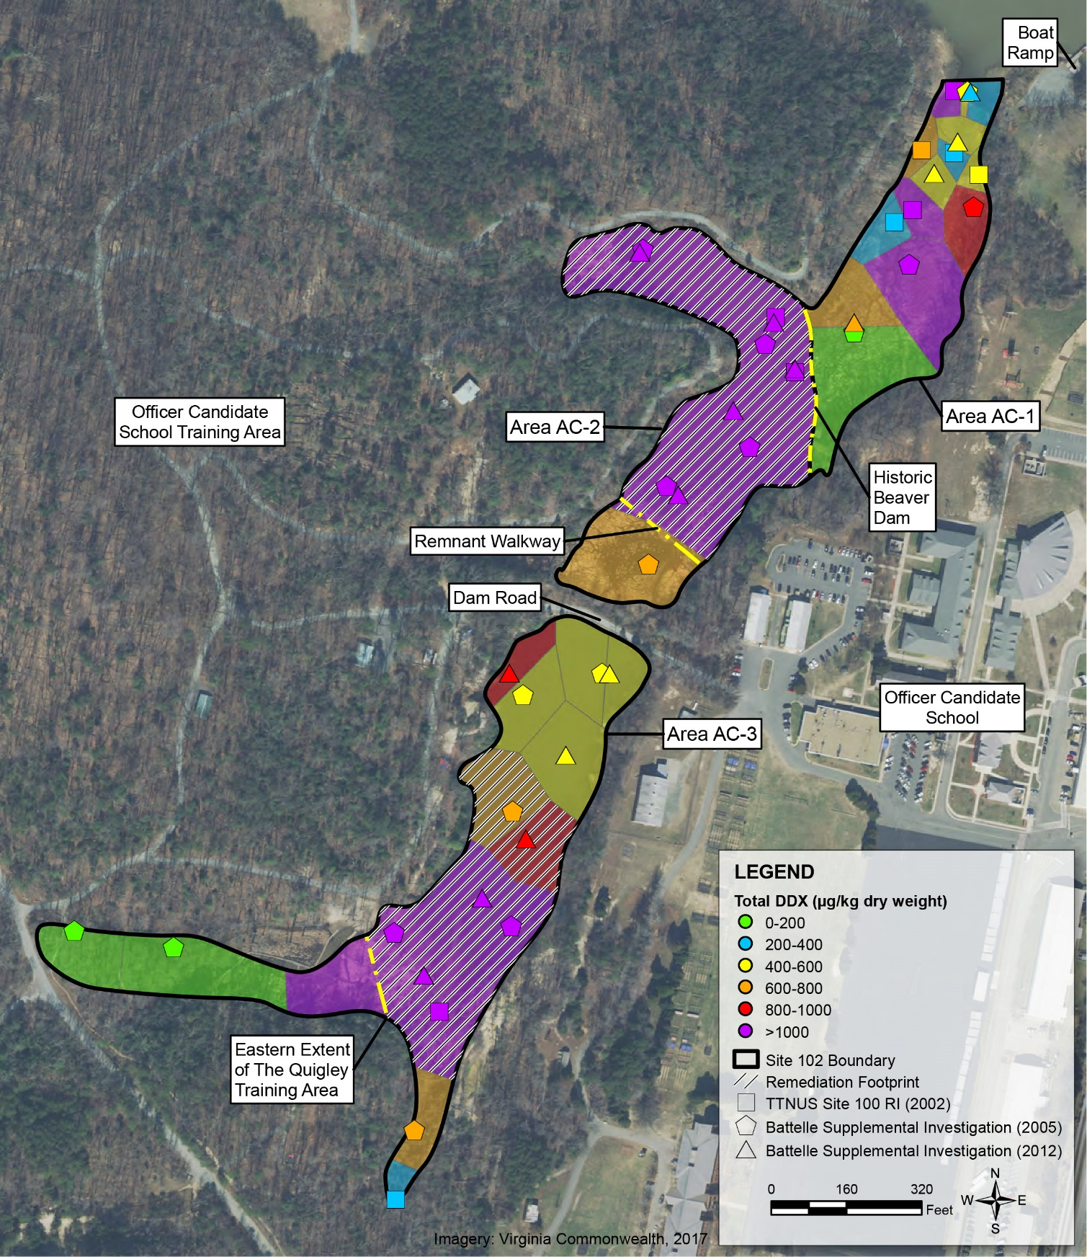
MCB Quantico Site 102 – Remedial Footprint
Area AC-1
SWAC was below PRG; thus, no active remediation required
Areas AC-2 and AC-3
Polygons were selected for active remediation so that post-remedy SWAC is below PRG
Area AC-3
Polygons for active remediation were selected to avoid Quigley Training Area
AC-1
AC-2
AC-3
(NAVFAC 2021)
Case Study #1 – MCB Quantico
Notes:
Key point – sediment at some locations with concentrations above the PRG can be left in place as long as the SWAC is below the PRG.
The higher concentration area in The Quigley shown in purple could remain in place because the SWAC for Area AC-3 was below the PRG if only the hatched portion of the polygon was included in the remedial footprint.

Slide 44
MCB Quantico Site 102 – Highlights
Approach presented in detail to Partnering Team
SWAC approach a possible first for US EPA Region 3; question about US EPA acceptance in other regions
Long-term monitoring required
SWAC approach led to a remedy that is protective, can be conducted in a limited time window, and avoids sensitive training areas
Site 102 Remedial Alternatives
Alternative | Description
1 | No action
2 | In situ treatment with activated carbon
3 | Thin-layer sand capping
4 | Partial excavation and offsite disposal
Note: Selected remedy is in Bold.
US EPA: United States Environmental Protection Agency
Case Study #1 – MCB Quantico
Notes:
In situ treatment with activated carbon could be completed in the limited time window that was available.
Long-term monitoring is included in the remedy to verify that the carbon treatment is effective and that the remedy is protective even though some sediment with DDT concentration above PRGs remained in place.

Slide 45
Presentation Overview
Introduction
SWAC Methodology
Case Study #1 – MCB Quantico
Case Study #2 – Portland Harbor
Other Site Examples
Wrap-up

Slide 46
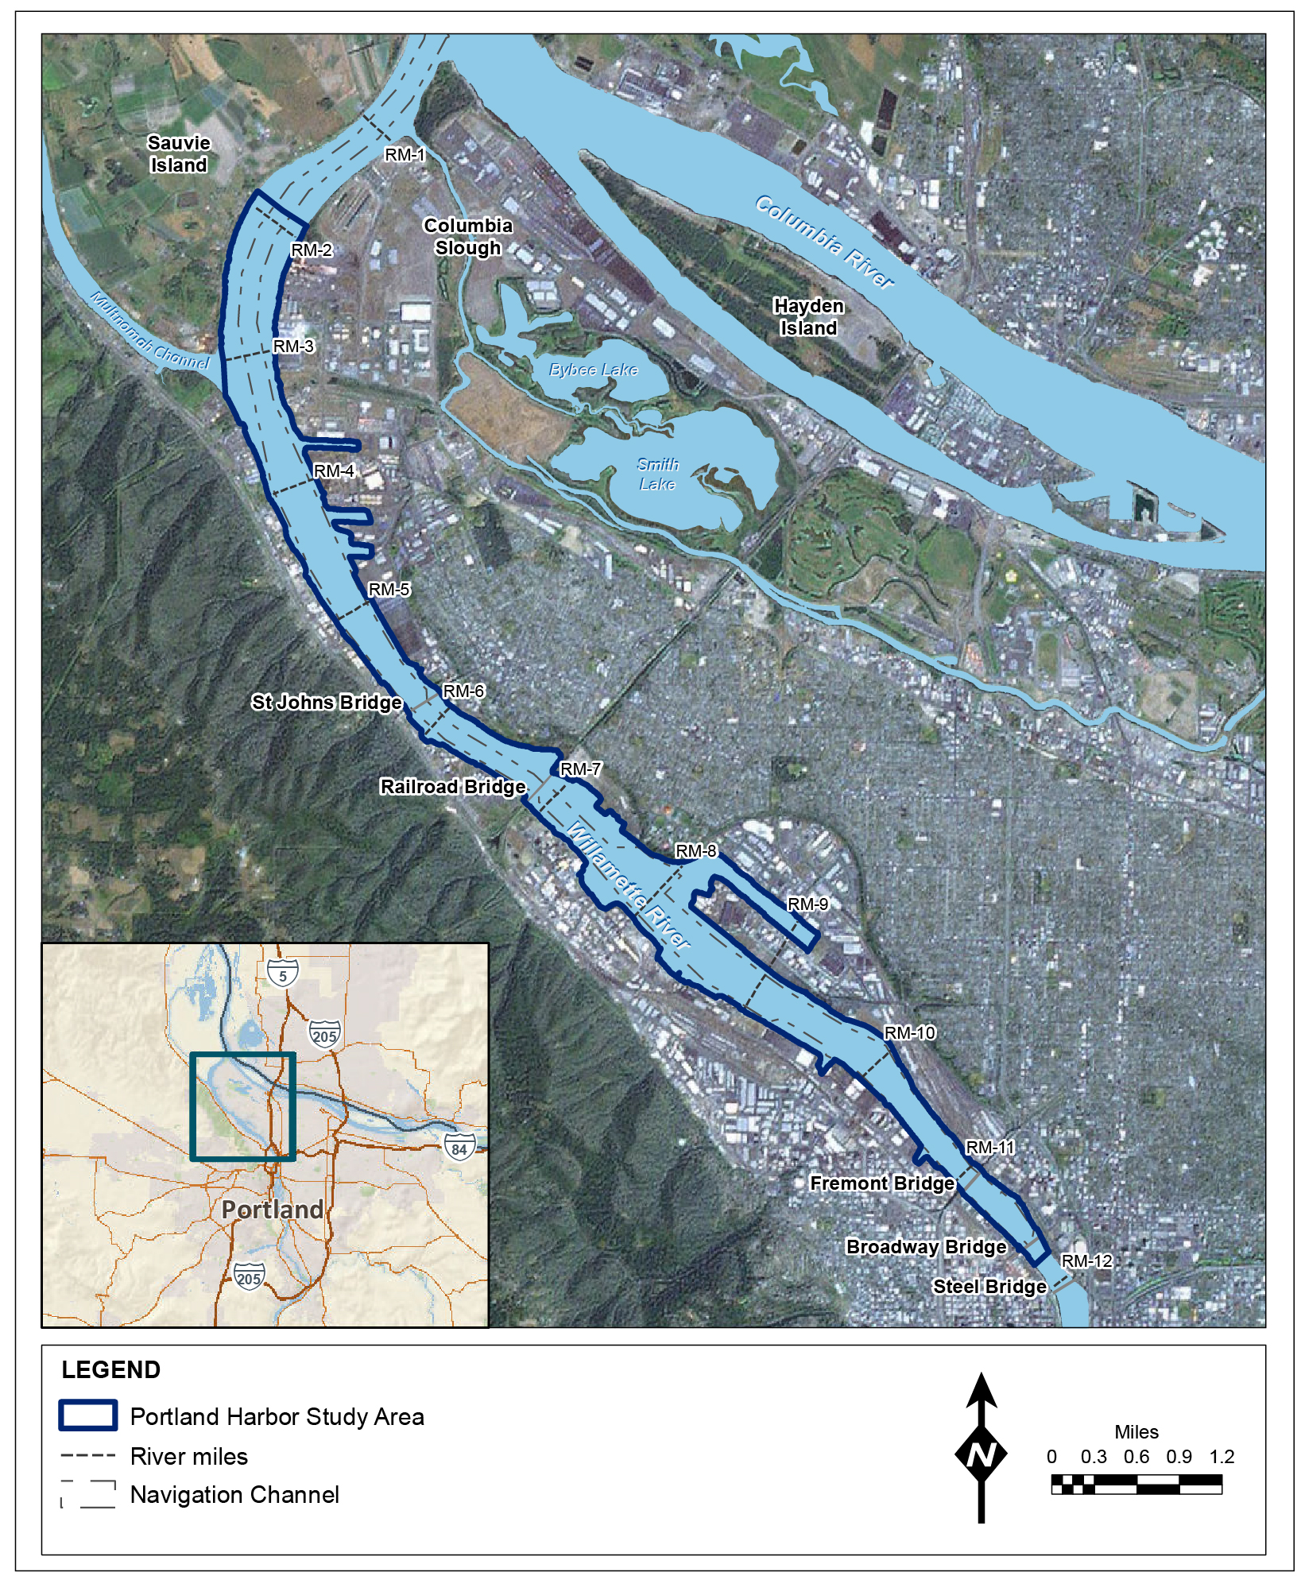
Portland Harbor – Conceptual Site Model
Large Superfund site on Lower Willamette River from river mile 1.9 to 11.8
Long history of shoreline modification, industrial activity, and maritime commerce
Focused COCs include PCBs, PAHs, several dioxin/furan congeners, and DDx; this case study focuses on PCBs
RAO 2: Reduce cancer and non-cancer risks to acceptable exposure levels (direct and indirect) for human consumption of COCs in fish and shellfish (note: site has eight other RAOs)
Navigation Channel
PAH: polycyclic aromatic hydrocarbon
(US EPA 2016)
Case Study #2 – Portland Harbor
Notes:
This case study is an example of using a SWAC approach on a large, complex site.
For the sake of simplicity, the case study focuses on PCBs, which are one of the main risk drivers based on consumption of PCB-contaminated fish and shellfish.
Note the federal navigation channel shown with dashed lines down the center of the project area – this boundary was used in the SWAC approach and is an example of a boundary that is based both on an administrative boundary and the CSM.

Slide 47
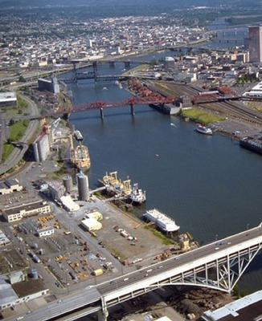
Portland Harbor – SWAC Areas
SWACs were calculated over area of entire site
FS
SWACs were calculated for 27 subareas
Sitewide SWAC was 95% upper confidence limit of the mean subarea SWAC concentrations
ROD
Sitewide SWAC was calculated over entire site based on comments received on SWAC methodology in FS
(US EPA 2023)
Case Study #2 – Portland Harbor
Notes:
In the FS, US EPA wanted to better understand the uncertainty around the SWAC but switched to a simpler SWAC approach in the ROD.

Slide 48
Portland Harbor – SWAC Method
SWACs calculated based on Natural Neighbor interpolation
Created spatial grid consisting of 10-foot by 10-foot pixels
Assigned each pixel a measured or interpolated concentration
Natural Neighbor interpolation method selected based on evaluation of statistical uncertainties
Zeros used as replacement values for remediated areas when estimating post-remediation SWACs
Case Study #2 – Portland Harbor
Notes:
The evaluation of statistical uncertainties associated with different interpolation methods was fairly complex; the project team concluded that the natural neighbor method performed reasonably well for estimating SWACs.

Slide 49
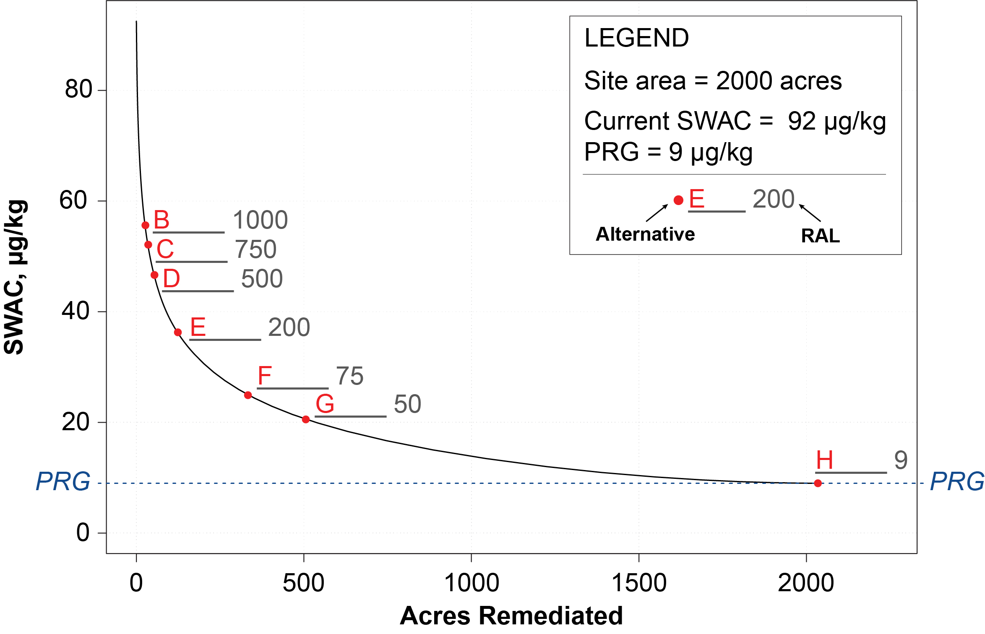
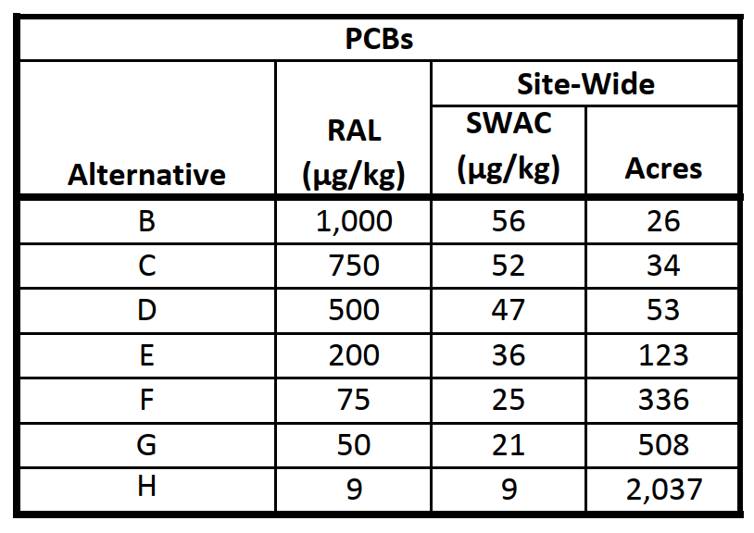
Portland Harbor – Remedial Alternatives
FS alternatives were based on a range of RALs; progressively more active remediation and less monitored natural recovery from Alt B to Alt H
Alternative I was added in Proposed Plan; different RALs in different parts of site to achieve consistent risk reduction in all areas
(US EPA 2016)
Case Study #2 – Portland Harbor
Notes:
A simplified version of this plot was shown earlier in the presentation when discussing the “knee of the curve” concept.
The red dots correspond to different remedial alternatives, from B to H (Alternative A was No Action); the gray numbers are the PCB RALs for each alternative.
The current SWAC is 92 µg/kg and the PRG is 9 µg/kg.
The table shows the estimated post-remediation SWAC and remedial footprint size for each alternative; the post-remedy SWAC gets progressively lower and the size of the remedial footprint gets progressively larger moving from Alternative B to Alternative H.

Slide 50
Portland Harbor – Remedial Footprints
Selected Remedy: Alternative F with modifications
Active Remediation (dredging and capping)
Lower RAL outside federal navigation channel
Higher RAL within federal navigation channel (principal threat waste threshold used for PCBs)
Monitored natural recovery outside of active remediation areas
LEGEND
PCB EPA RALs
RAL B (> 1000 µg/kg)
RAL C (> 750 µg/kg)
RAL D (> 500 µg/kg)
RAL E (> 200 µg/kg)
RAL F (> 75 µg/kg)
RAL G (> 50 µg/kg)
RAL H (> 19 µg/kg)
(US EPA 2016)
Case Study #2 – Portland Harbor
Notes:
The sediments tend to be more highly contaminated in the nearshore areas outside of the navigation channel compared to inside the channel.
The Alternative F RALs were selected for the nearshore areas; the 75 µg/kg RAL for PCBs is near the knee of the curve.
Higher RALs were selected for the navigation channel based on CSM considerations.
For PCBs, a threshold other than the RAL is used to identify areas for active remediation, which is an example of another factor coming into play on a complex site.

Slide 51
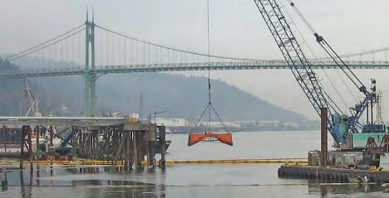
Portland Harbor – Highlights
Stakeholder concerns related to SWAC/RAL approach
Age of data – some samples more than 10 years old
Lack of transparency
Rationale for selected remedy
Best balance of tradeoffs among balancing criteria, addressed many of public’s concerns
Reduces risks within a reasonable time frame, provides for long-term reliability, and minimizes reliance on institutional controls
(US EPA 2023)
Case Study #2 – Portland Harbor
Notes:
Age of data should be considered for any site using a SWAC approach. This can be particularly problematic on large sites, where it may take a long time to move through the CERCLA process from the RI to the ROD.
Some stakeholders thought that the preferred remedy was too aggressive while others thought that it relied too much on MNR; the selected remedy tried to balance these concerns.

Slide 52
Presentation Overview
Introduction
SWAC Methodology
Case Study #1 – MCB Quantico
Case Study #2 – Portland Harbor
Other Site Examples
Wrap-up

Slide 53
Navy Sites Where SWACs Have Been Used
Site | SWAC Method | COC(s) Averaged | Purpose
Washington Navy Yard OU 2 | Thiessen polygons | PCBs | Remedial footprint
MCB Quantico Site 102 | Thiessen polygons | DDx | Remedial footprint
Naval Air Station Oceana Dam Neck Annex | Interpolation (IDW) | Lead | Net environmental benefit analysis
Pearl Harbor Sediment | Thiessen polygons | PCBs, metals | Remedial footprint
Apra Harbor Sediment | Thiessen polygons | PCBs, PCDD/F | Remedial footprint
Hunters Point Naval Shipyard Parcel F | Thiessen polygons | PCBs | Remedial footprint
Naval Support Facility Indian Head | Interpolation (unspecified) | Mercury, lead | Remedial footprint
Bremerton Naval Complex OU B Marine | Thiessen polygons | PCBs | Remedial footprint
Other??
IDW: investigation-derived waste
OU: Operable Unit
PCDD/F: polychlorinated dibenzodioxin/polychlorinated dibenzofuran (dioxins/furans)
Other Site Examples
Notes:
Note that most of these examples used a Thiessen polygon approach to develop remedial footprints.
Does anybody in the audience have other Navy site examples to add?

Slide 54
Presentation Overview
Introduction
SWAC Methodology
Case Study #1 – MCB Quantico
Case Study #2 – Portland Harbor
Other Site Examples
Wrap-up

Slide 55
Wrap-up
Use a SWAC approach to develop most cost-effective remedy that reduces risk and accommodates site operational activities
Consult with a geospatial analysis expert when selecting and developing SWAC methodology
Engage regulators and partners when developing SWAC approach and remedial footprint
Clearly document approach for determining compliance with RGs in ROD (SWAC or point basis)
(NOAA 2023)
Wrap-up
Notes:
Strive for transparency; ambiguity can cause confusion and prolong the time needed to reach consensus on a remedy.

Slide 56
References
AECOM. 2016. Feasibility Study, Pearl Harbor Sediment, Joint Base Pearl Harbor Hickam, Oahu, Hawaii. Final. June.
Battelle, M. Otten, and Neptune and Company, Inc. 2007. Quantico Embayment (Site 99), Southern Wetlands (Site 96), and Potomac River Southern Area 1 Feasibility Study, Marine Corps Base Quantico, Quantico, Virginia. Final. March.
CH2M HILL, Inc. (CH2M). 2020. 2018 OU B Marine Long-Term Monitoring and OU A Intertidal Sediment Sampling Report, Puget Sound Naval Shipyard Superfund Site, Naval Base Kitsap Bremerton, Bremerton, Washington. August.
CH2M. 2021. Net Environmental Benefit Analysis, Former Skeet and Trap Range (UXO 08), Dam Neck Annex Naval Air Station Oceana, Virginia Beach, Virginia. Prepared for NAVFAC Mid-Atlantic. April 21.
Easterly, R., D. Salstrom, and J. Pottmeyer. 2017. Upland Vegetation of the Central Hanford Site. HNF-61417, Rev. 0. Mission Support Alliance, Richland, Washington
ICF, Inc. and Sundance Environmental and Energy Specialists, LTD (ICF and Sundance). Palos Verdes Shelf Technical Memorandum. Prepared for the U.S. Environmental Protection Agency Region 9. Final. November 21.
Interstate Technology Regulatory Council (ITRC). 2014. Contaminated Sediments Remediation: Remedy Selection for Contaminated Sediments. August. https://projects.itrcweb.org/contseds_remedy-selection/.
ITRC. 2016. Geospatial Analysis for Optimization at Environmental Sites. https://gro-1.itrcweb.org/.
Jacobs. 2018. Final Cable Crossing Area Hybrid Dredge Data Report. ACE-J23-35BG2000-M17-0038. Prepared for U.S. Army Corps of Engineers. September.
Kern, J. 2019. Developing and Using Surface Weighted Average Concentrations (SWACs). US EPA ORD Contaminated Sediments Virtual Workshop Series – Session 4 Long-term Monitoring. November 20.
National Oceanic and Atmospheric Administration (NOAA). 2023. Damage Assessment, Remediation, and Restoration Program – Passaic River. https://darrp.noaa.gov/passaic-river.
Wrap-up

Slide 57
References
Naval Facilities Engineering Systems Command (NAVFAC). 2021. Proposed Remedial Action Plan, Site 102 (Abraham’s Creek), Marine Corps Base Quantico, Quantico, Virginia. April.
NAVFAC. Forthcoming. Case Studies Using Surface Weighted Average Concentration Methods at Sediment Remediation Sites.
Pelletier, D., V. Paris Sacks, M. Sorensen, and V. Magar. 2019. “Review of Remediation Goals at Contaminated Sediment Sites in the United States.” Integrated Environmental Assessment and Management. Vol. 15, No. 5. pp: 772-782. April. https://setac.onlinelibrary.wiley.com/doi/abs/10.1002/ieam.4162.
Smith, A.R., M.E. Esten and D.J. Dickerson. 2023. Non-Dredging Remediation at the New Bedford Harbor Superfund Site. Eleventh International Conference on the Remediation and Management of Contaminated Sediments. Austin, Texas. January.
United States Environmental Protection Agency (US EPA). 2005. Contaminated Sediment Remediation Guidance for Hazardous Waste Sites. Washington, DC, OSWER 9355.0-85.
US EPA. 2010. Field Study on Environmental Dredging Residuals: Ashtabula River. Volume I. Final Report. EPA/600/R-10/126. September.
US EPA. 2016. Portland Harbor Remedial Investigation and Feasibility Study. Prepared by EPA and CDM Smith. June.
US EPA. 2023. Portland Harbor Superfund Site – Connecting to the Willamette River. United States Environmental Protection Agency Region 10. https://storymaps.arcgis.com/stories/ab89faf239624854a5b9c7723f1c43da.
United States Environmental Protection Agency, CH2M HILL, Inc., and ITSI. 2009. Feasibility Study, Palos Verdes Shelf Superfund Site, Operable Unit 5 of the Montrose Chemical Corp. Superfund Site. May.
United States Geological Survey (USGS). 2023. Public Domain photograph. https://www.usgs.gov/media/images.
Wasser, l. and T. Goulden. 2021. Going on the Grid – An Intro To Gridding and & Spatial Interpolation. National Ecological Learning Network (NEON). https://www.neonscience.org/resources/learning-hub/tutorials/spatial-interpolation-basics.

Slide 58
Points of Contact
Presenter
Patty White
Jacobs
(617) 721-2527
patricia.white@jacobs.com
Topic Champion
Amy Hawkins
NAVFAC EXWC
(805) 844-8662
amy.l.hawkins16.civ@us.navy.mil
Wrap-up

Slide 59
Questions

